Slide 1

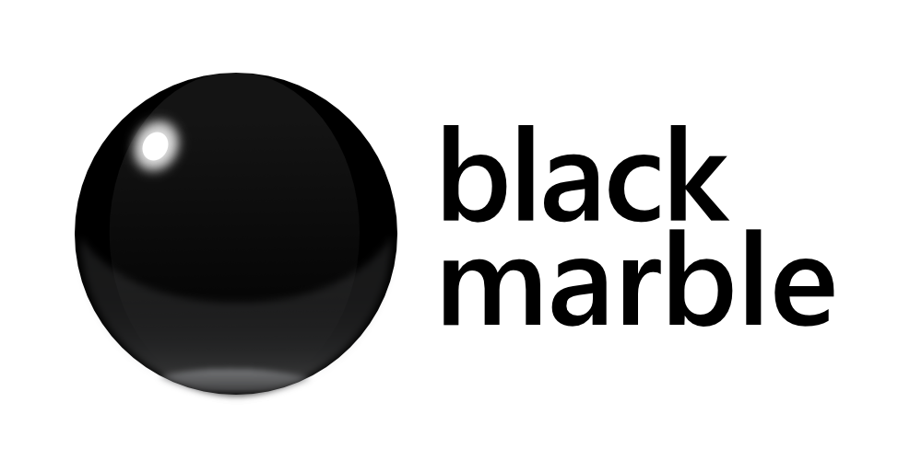

Introduction to
Microsoft Bot Framework
@developerday
James Mann
Microsoft MVP & Development Consultant
Black Marble @jamesemann
Notes:
Thanks for turning out to this session. It’s good to see that people are interested in this new technology.
Just to set your expectations
Today we are going to look at creating Bots with Microsoft Bot Framework.
Because I am a .NET developer, the examples I will show you today are in C#. But everything you see here can be done with Node JS as well.
Maybe do a show of hands .NET / Node / Other

Slide 2

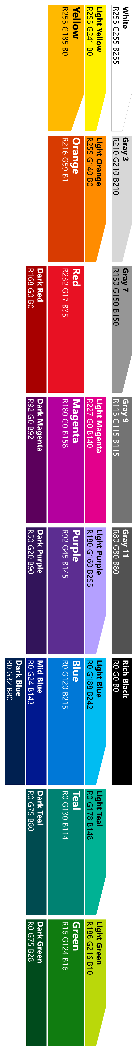
Agenda
What is a chatbot?
Why chatbots?
What is Bot Framework
Building conversations
luis.ai
Notes:
The aim of today is to introduce you to the bot framework
Give you everything you need to get started

Slide 3
https://github.com/jamesemann/ddd2017
Code
Notes:
All the code is available in github here. I’ll put this on again when we wrap up

Slide 4
What is a chatbot?
@jamesemann
Notes:
Helpful to understand what a chatbot actually is because the term bot is quite overloaded
So by way of example you will see that

Slide 5
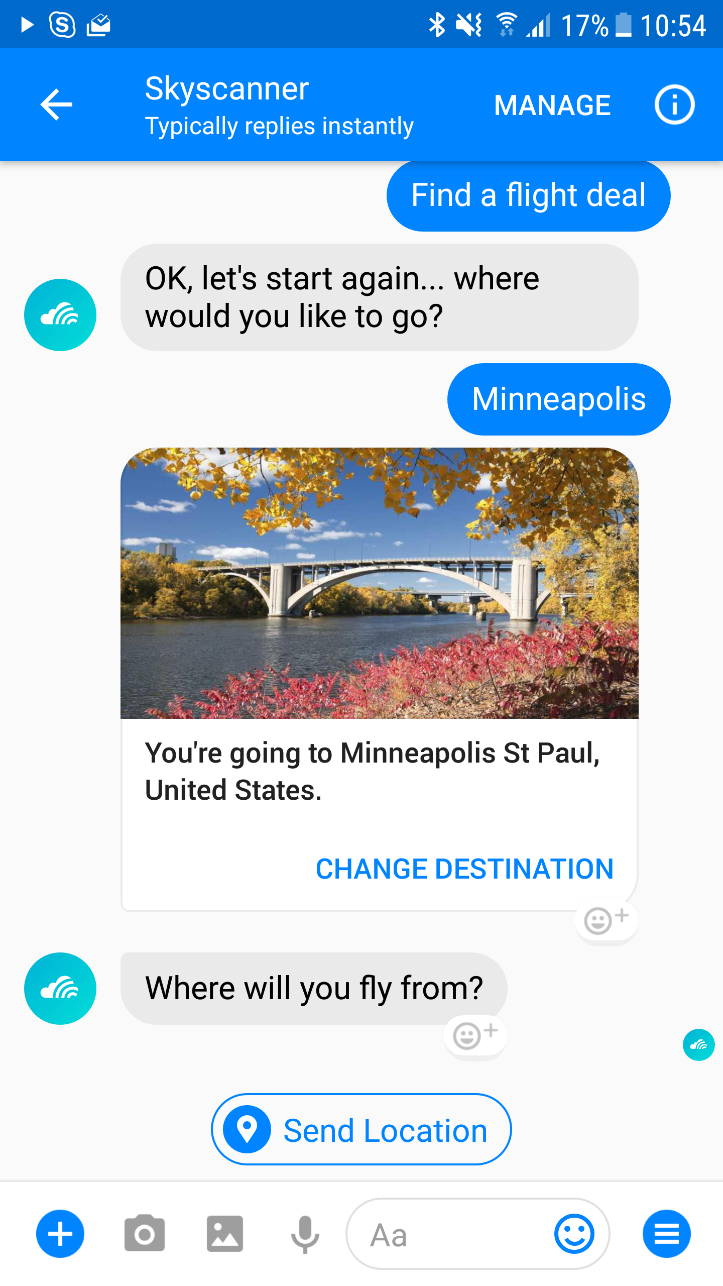
Notes:
I am calling a bot, a software application that is delivered over messaging applications
This may use a conversational interface, or command and control
This example is skyscanner, it lets you find out about flights without installing any software
It’s a nice natural—in this case conversational– interface
That has a really low barrier to entry.

Slide 6

Notes:
But also consider less conventional applications “accessible through email” as bots as well
x.ai is a popular scheduling assistant, that can help avoid scheduling ping pong between meeting participants. Microsoft have a similar email scheduling bot calendar.help

Slide 7
Why chatbots?
@jamesemann
Notes:
That was a quick definition of a bot, so lets talk about why they have become popular

Slide 8
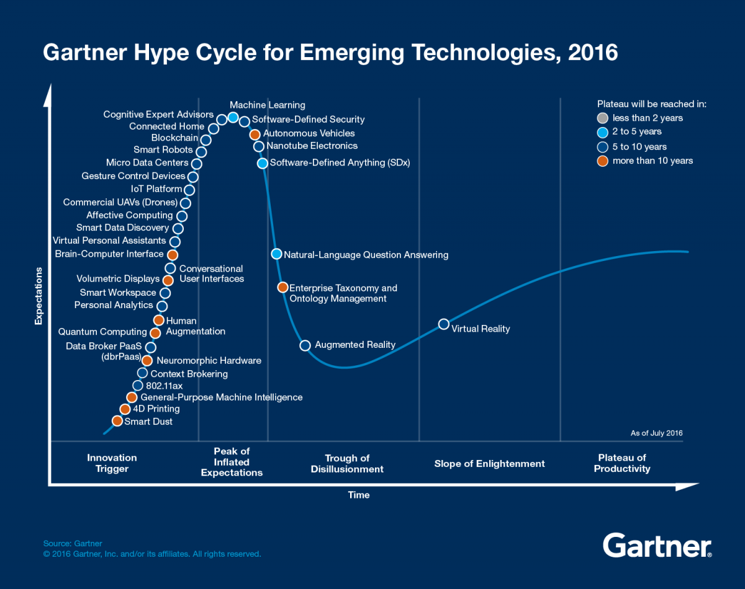
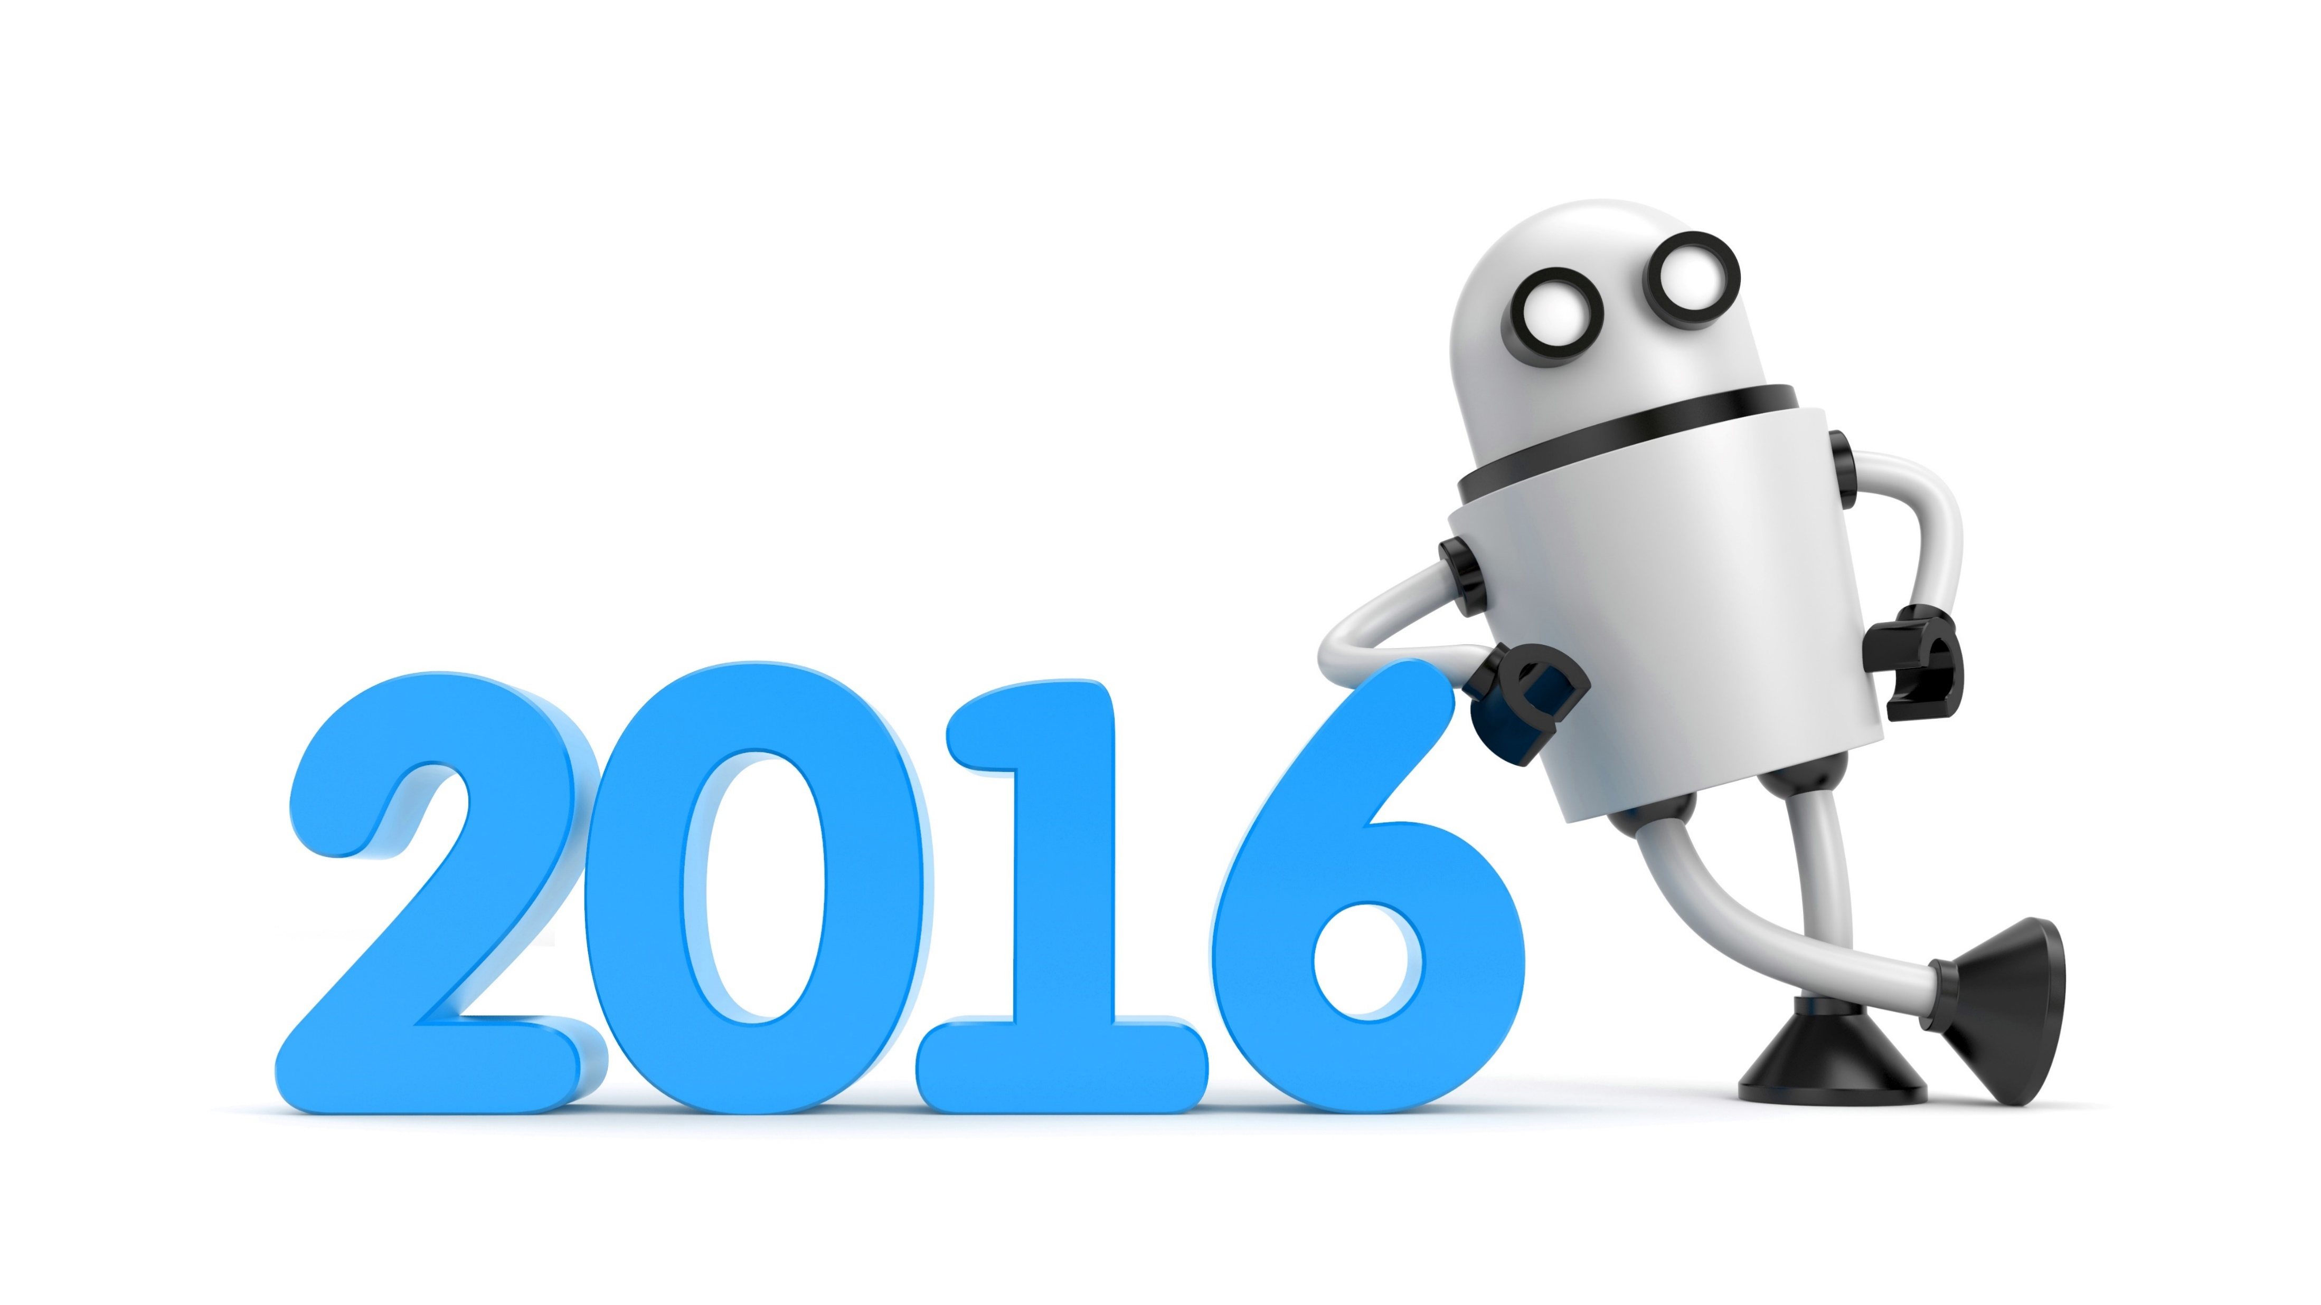
Hype mostly around distribution
But also.. natural language and the AI landscape
Year of the chatbot
Notes:
2016 was called year of the bot,
In 2016 you can see Conversational User interface and Virtual Personal Assistants are on the innovation trigger heading up to the peak of inflated expectations.
Interestingly, Gartner predict that the hype wont plateau for 5-10 years. So the hype rollercoaster is set to continue for a couple more years at least.
Why is it so interesting? Lets take a look
Most cited reasons:
#1 distribution
#2 better experience?? (engage with the chat generation)

Slide 9
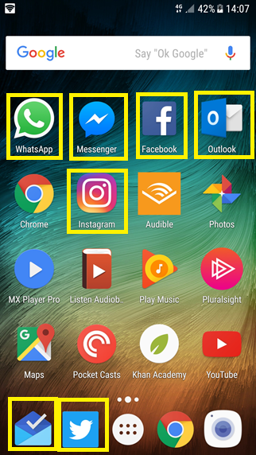
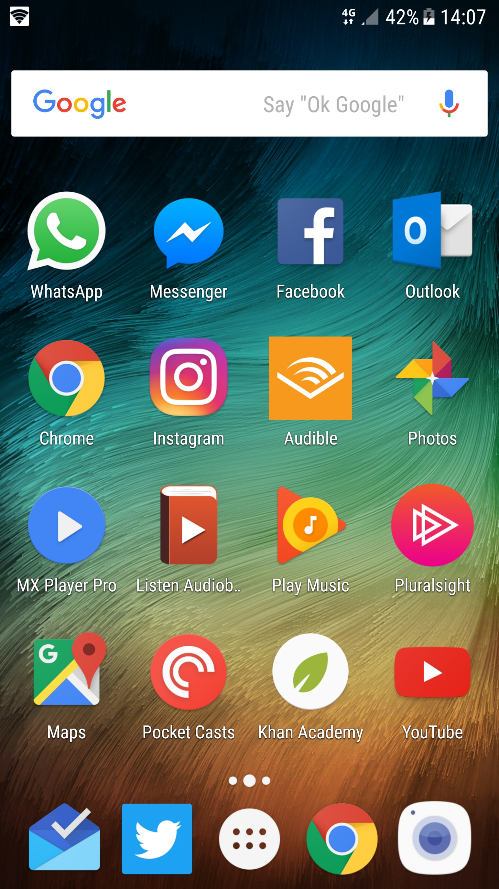
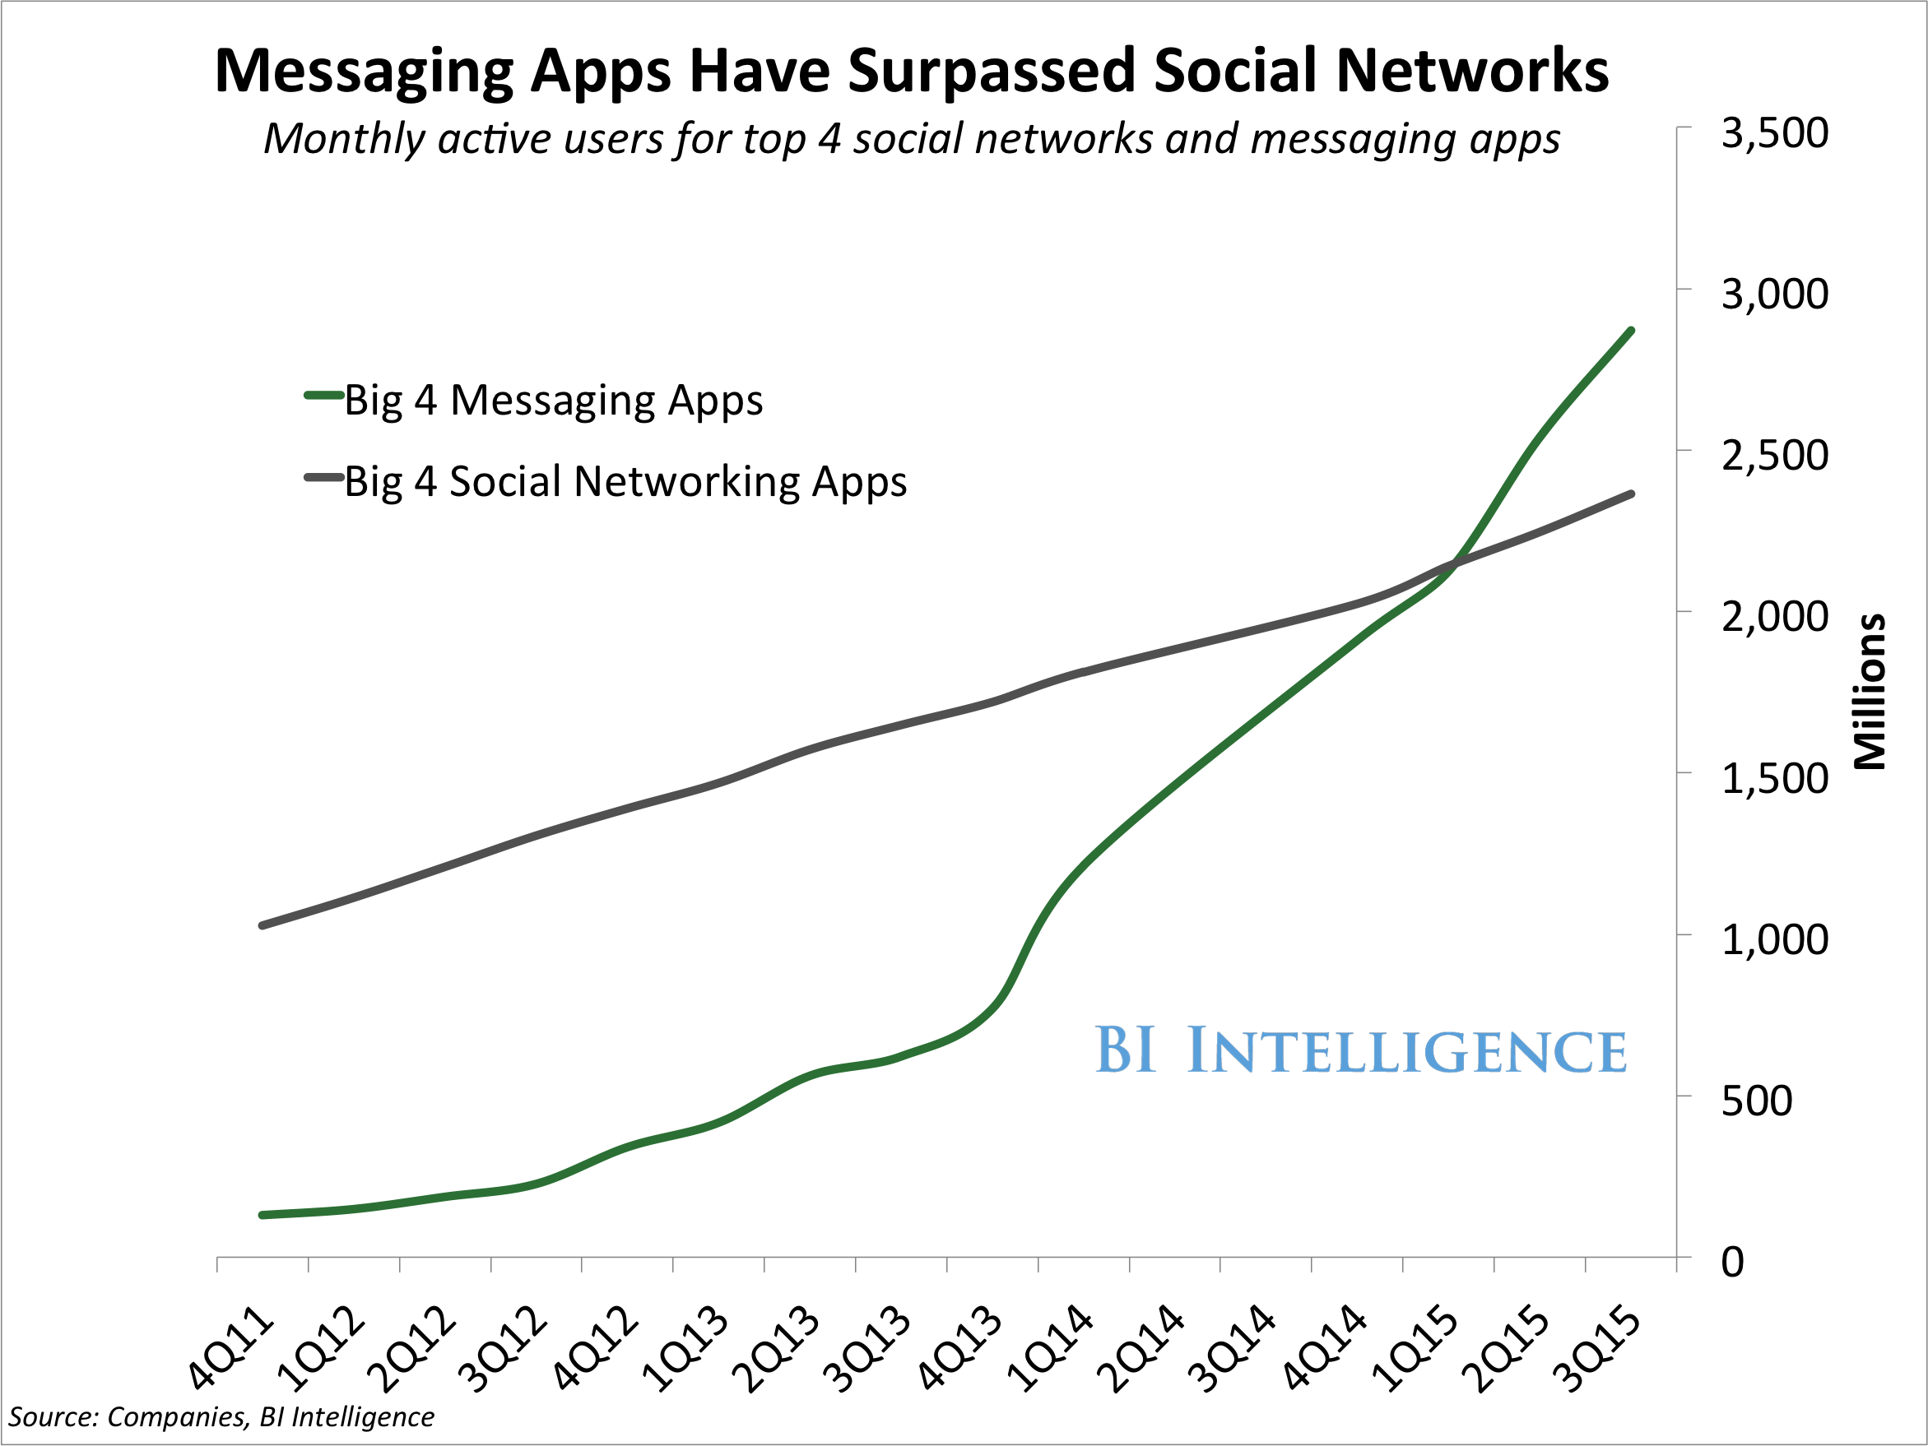
Distribution
Over 4 billion global users using messaging platforms
6 out of the top 10 apps used globally are messaging apps
Notes:
So the big selling point is distribution.
Everyone has a device on them. People are addicted to their phones, and particularly messenger apps.
Chatbots take advantage of this by using messenger apps and virtual assistants to reach users where they are already active.
Take a look at your phone home screen. Count how many messaging/assistant apps you have on there. Count things like email too because you have seen that chatbots can be delivered across all these channels.
It’s a really compelling distribution story and I think it is the number one reason for chatbot hype.

Slide 10














There is a messaging ecosystem
Notes:
So digging into it from a bot framework perspective. There are 12 messaging channels supporting messaging apps and virtual assistants. 3 new channels were announced at //BUILD –
Bing search
Skype for business
cortana

Slide 11
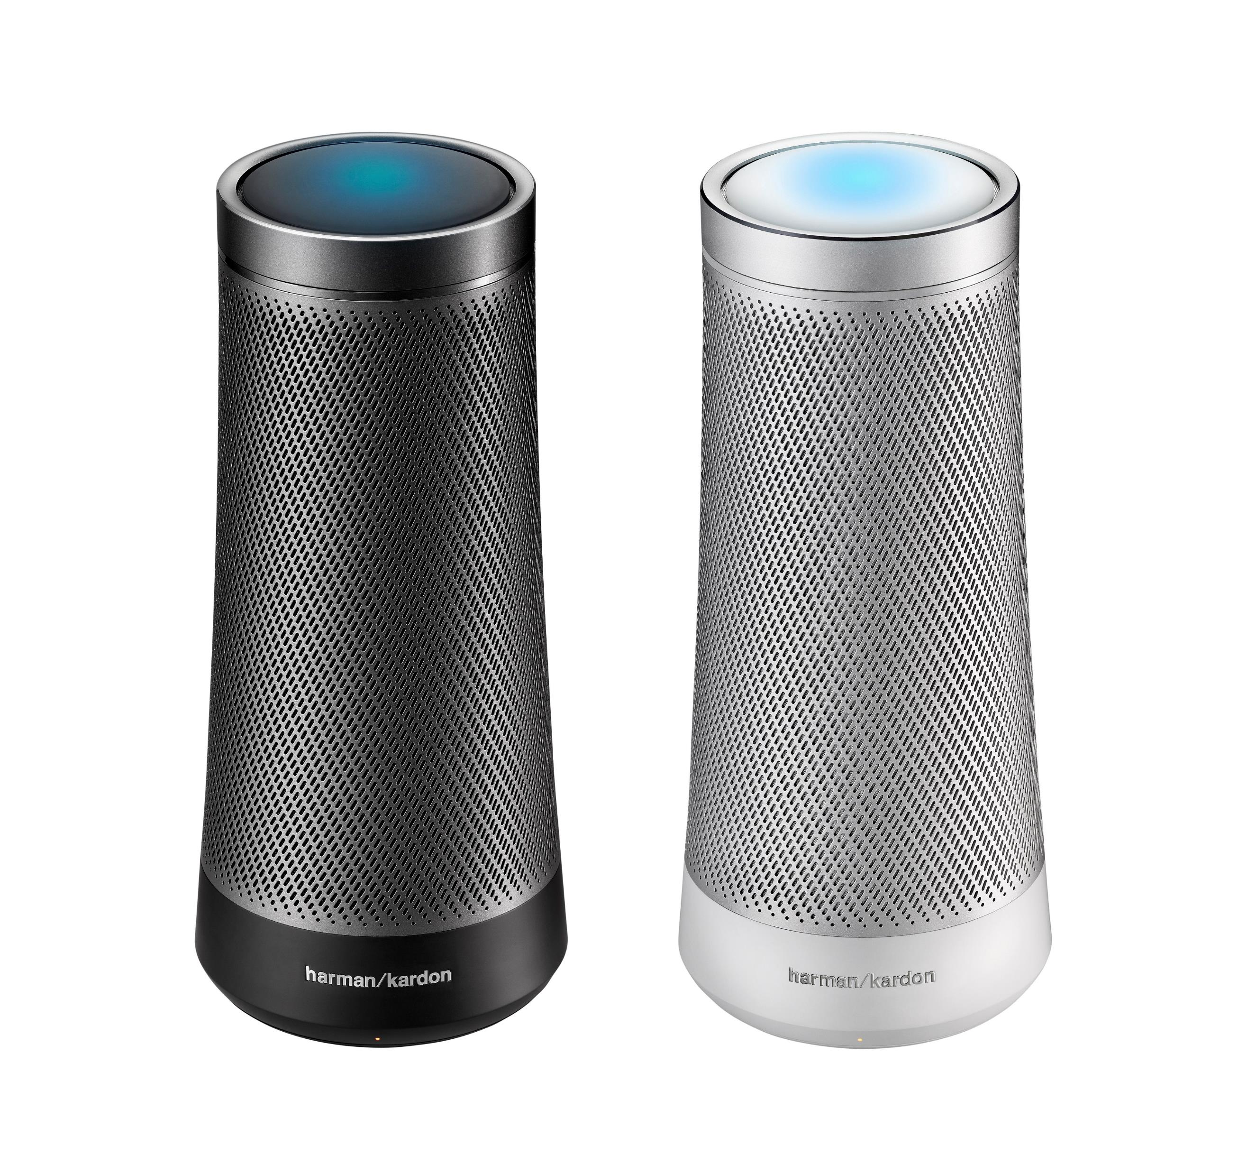
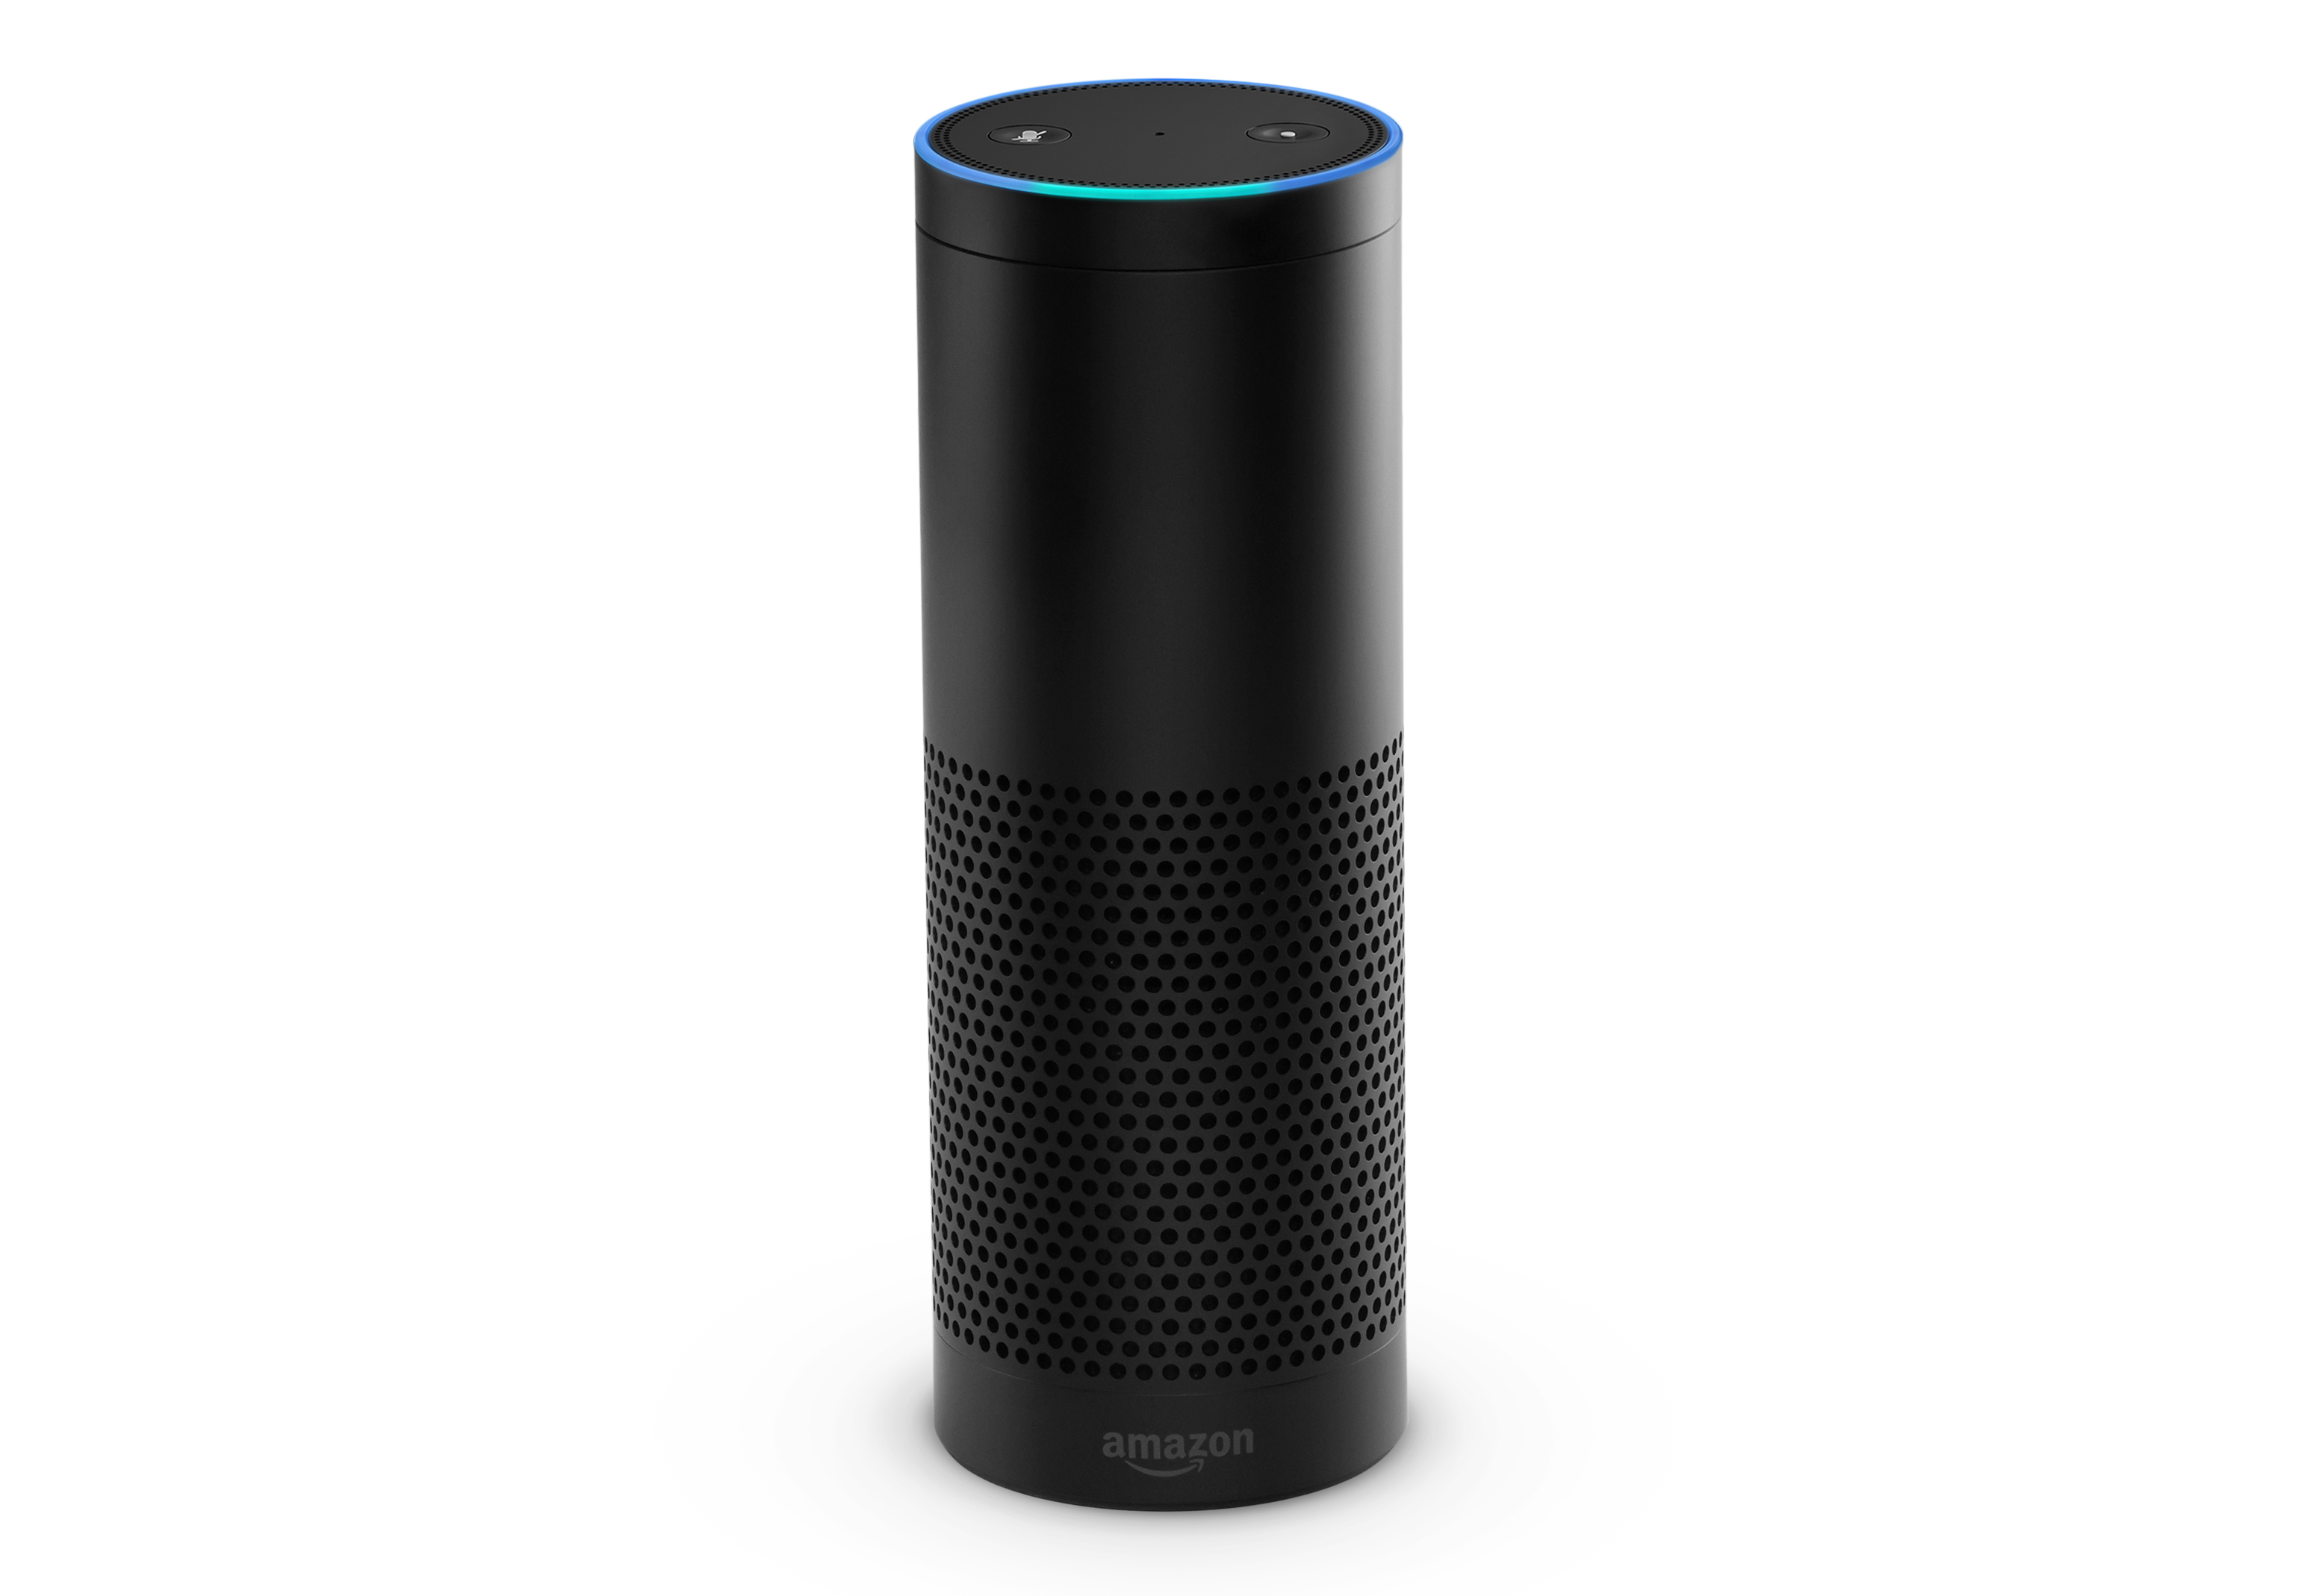
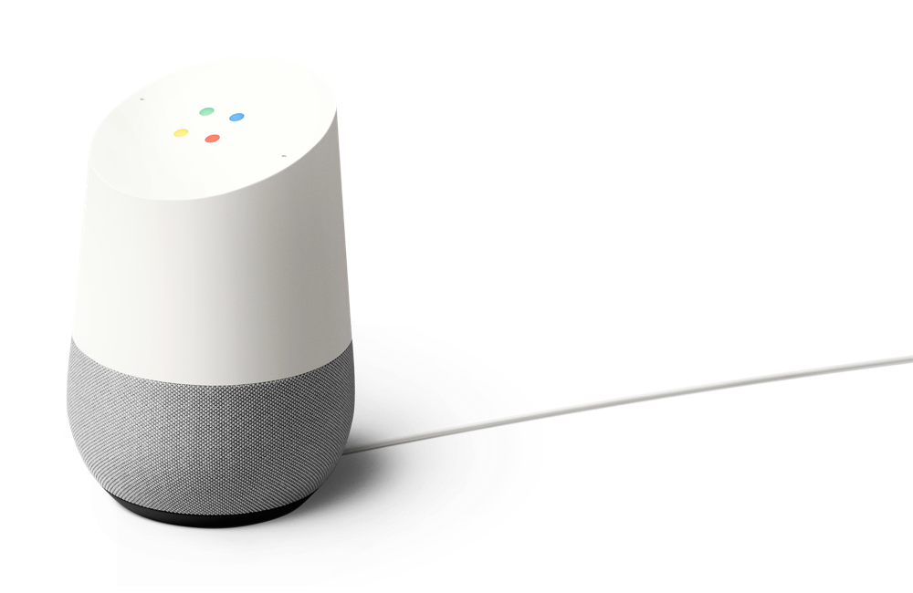
And a virtual assistant device ecosystem
Notes:
And these dedicated virtual assistant devices are becoming mainstream.
Everyone has seen the examples GOOD and BAD of amazon alexa.
Google home has recently become available in the UK
And dedicated cortana devices are on their way.

Slide 12
Use cases are everywhere
Customer Service
Shopping Experience
Help Desk
Employee Support
FAQ
Account queries
Resolve order issues
Parcel Tracking
Transport queries (bus, train)
Recommend product
Flight, hotel booking
Improving search
Find the right product
Problem troubleshooting
New user on-boarding
Response suggestion
Product information
Data insights
Find the right expert
HR – booking holiday, fault reporting
Meeting room booking
Notes:
So there are tons of use cases for chatbots. Some are just delivering existing functionality through a new experience, but others, like x.ai are bot first applications, made possible with the distribution and channel capabilities.
Not every use case is appropriate though. Bots tend to work very well when the application is precise.
Here I’ve highlighted an example of a use case that doesn’t work very well. If you think of how a lot of people shop, they don’t typically have a specific product already in mind. They want to maybe browse a catalogue, and discover and get a wide range of inspiration before narrowing down their product. Chatbots make this difficult because the canvas capabilities require information to be more precise.

Slide 13
What is Bot Framework?
@jamesemann
Notes:
So, now you understand the what and why, lets look at the tools and services that bot framework gives you to create your own bots.

Slide 14
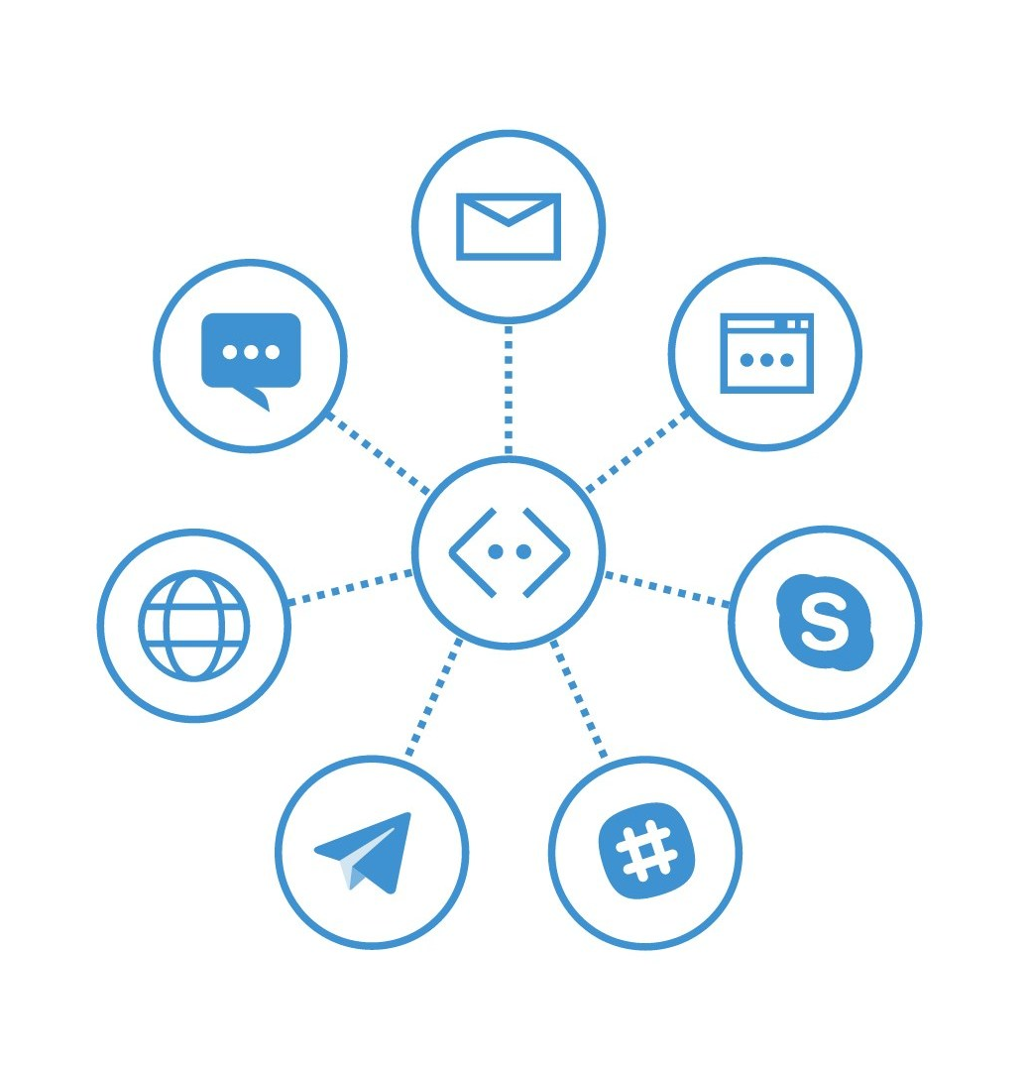
Bot Framework
Build, host and maintain one chatbot
Target multiple channels
Notes:
If you were to create chatbots natively, you would have to create an implementation of the same chatbot for each channel you wanted it to run on.
Bot framework acts as a chatbot broker, where you write a single chatbot application , and let bot framework provide the plumbing to the channels through configuration.
It allows you to focus on your business logic, and be agnostic of how the bot connects to the channels under the hood.

Slide 15
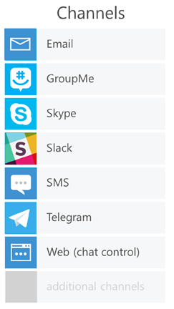
Bot Framework Architecture
Your Bot’s web service
Bot Connector
Routes messages
Manages state
Bot registration, directory
Session tracking
Services (translation…)
Per-user, per-bot storage
SDK, APIs
Your Bot logic
Bot Builder SDK (Node.js + C#)
Notes:
In terms of architecture, there are three components,
On the left, we have your bot application, which is an ASP.NET web api / node web service
Your bot application makes use of the bot connector, which is a logical grouping of SDKs, bot registration and administration
Finally the components in the bot connector provide the connectivity to distribute across channels.

Slide 16
Your first chatbot
@jamesemann
Notes:
So, how do we get started?
Well, I like to break it down into three simple steps.

Slide 17
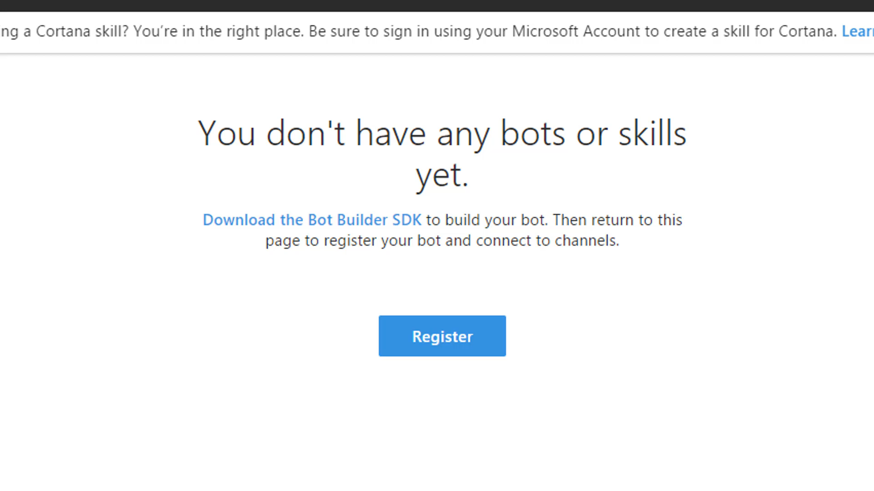
Register
Register
Register your chatbot
through the
Bot Framework Portal
Notes:
First you register the Bot.
You give your bot a name, an icon, provide an API endpoint that it will talk to.

Slide 18
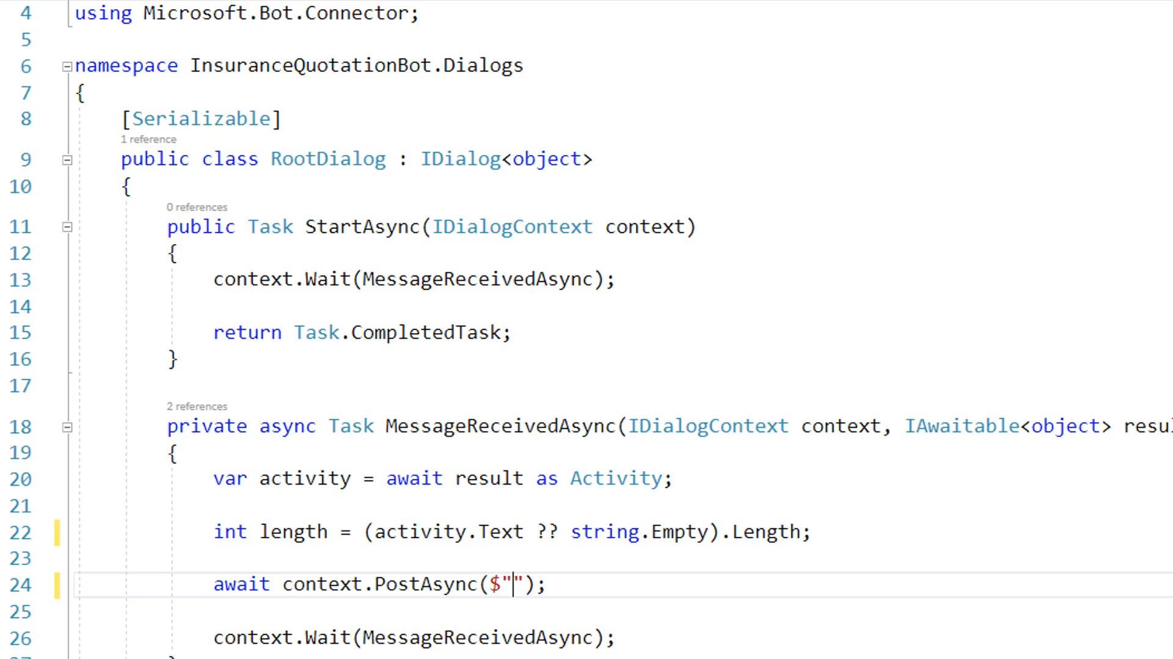
Register
Build
Build your chatbot using
C# or Node JS
Notes:
Then build using C# or Node JS

Slide 19
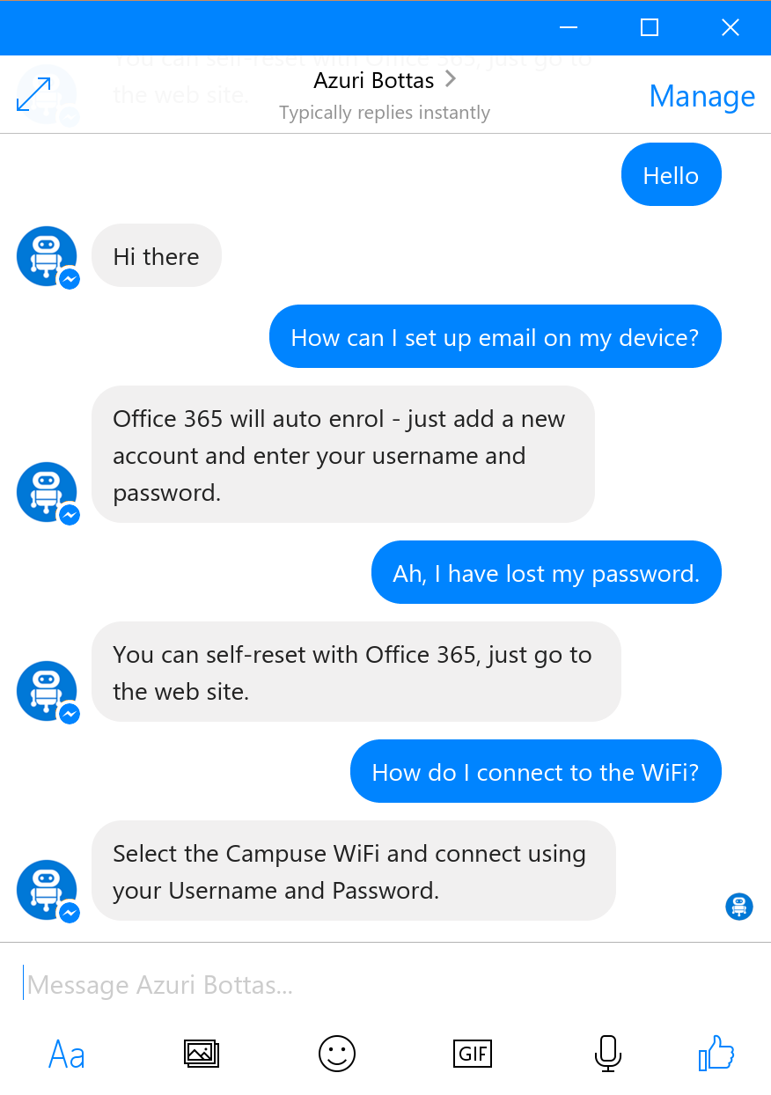
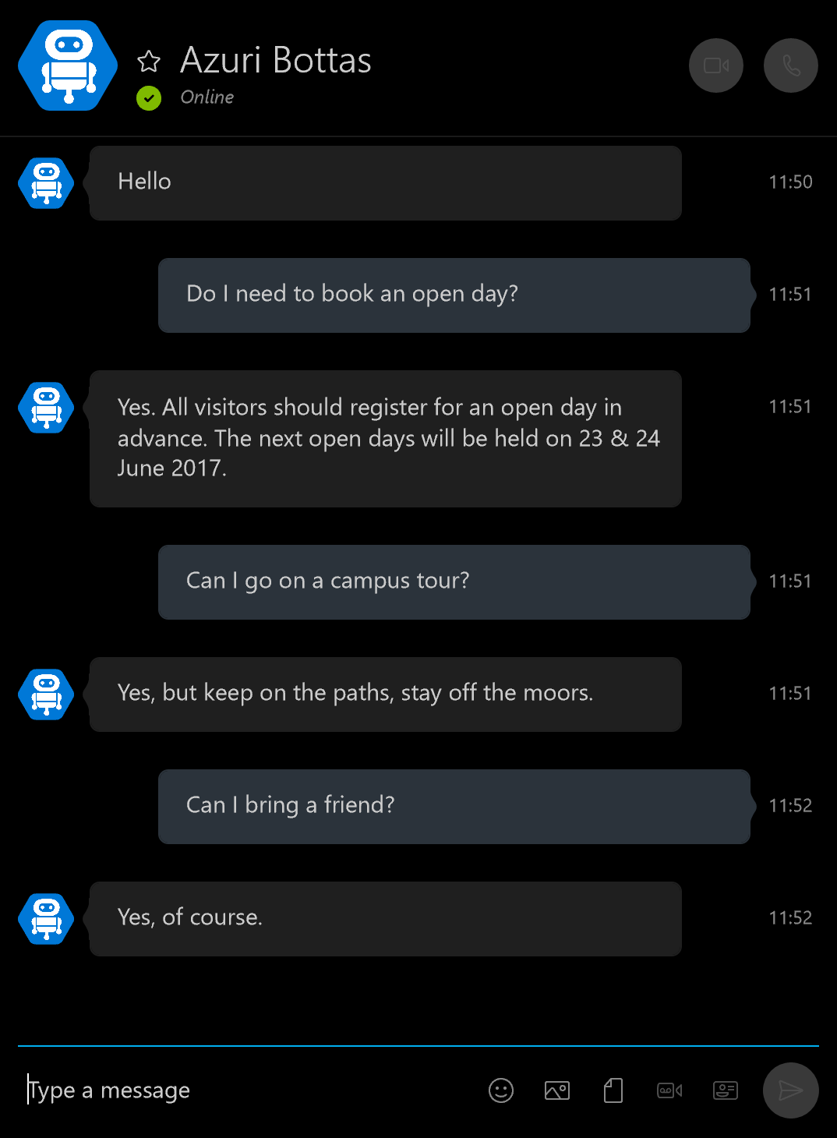


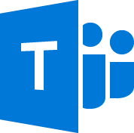



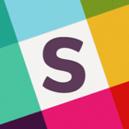


Distribute
Facebook
Skype
& more!
Notes:
Then you distribute.
This is all done by turning on the channel in the portal. once you have defined your Bot application and does not require code changes!
Here I am exposing my bot over facebook, then skype,
I can choose at any time, to distribute to any of the other channels currently supported by Bot framework.
And – a key benefit – if channels are added in future – my bot is already future proof!

Slide 20
Demo
Your first chatbot
@jamesemann
Notes:
Lets take a look at creating the chatbot and testing using the channel emulator

Slide 21
Modelling your conversation
Roll your own
state management etc
Multi layered conversations
Bespoke
Dialogs
Data capture,
“Web forms” scenarios
Flexibility
FormFlow
Questions and answers (FaQ),
Command and control
QnA
Effort to implement
Notes:
So when you are first starting your conversation, you have a decision to make about which tools you use.
This depends on the type of conversation.
I’ve tried to show this in the diagram
along the bottom is the amount of effort required to implement.
Along the side is the amount of flexibility
So basically,
if you have a simple bot scenario you are going to be looking at the bottom left
If you have a complex scenario you are going to be looking at the top right
We are going to be focussing on Dialogs, which gives you benefits of state management, persistence etc while giving you a good level of flexibility

Slide 22
Dialogs
@jamesemann
Notes:
Dialogs are the core building block, so we will look at them first

Slide 23
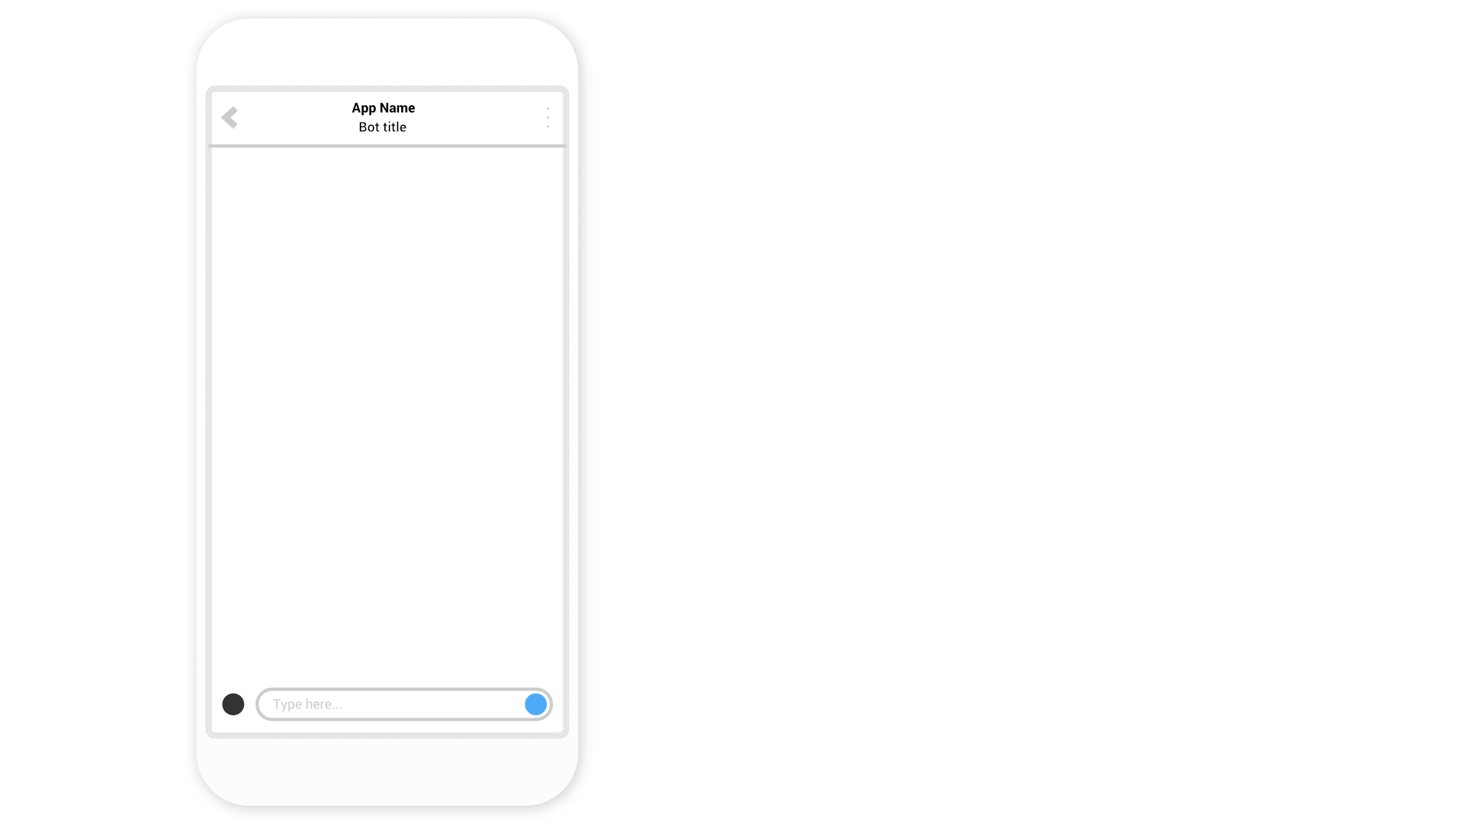
Conversational banking
Notes:
Talk through an example of a BANKING BOT
Can do a couple of simple tasks
Check balance (savings or current)
And make a payment

Slide 24
Notes:
Talk through an example of a BANKING BOT
Can do a couple of simple tasks
Check balance (savings or current)
And make a payment

Slide 25


Slide 26
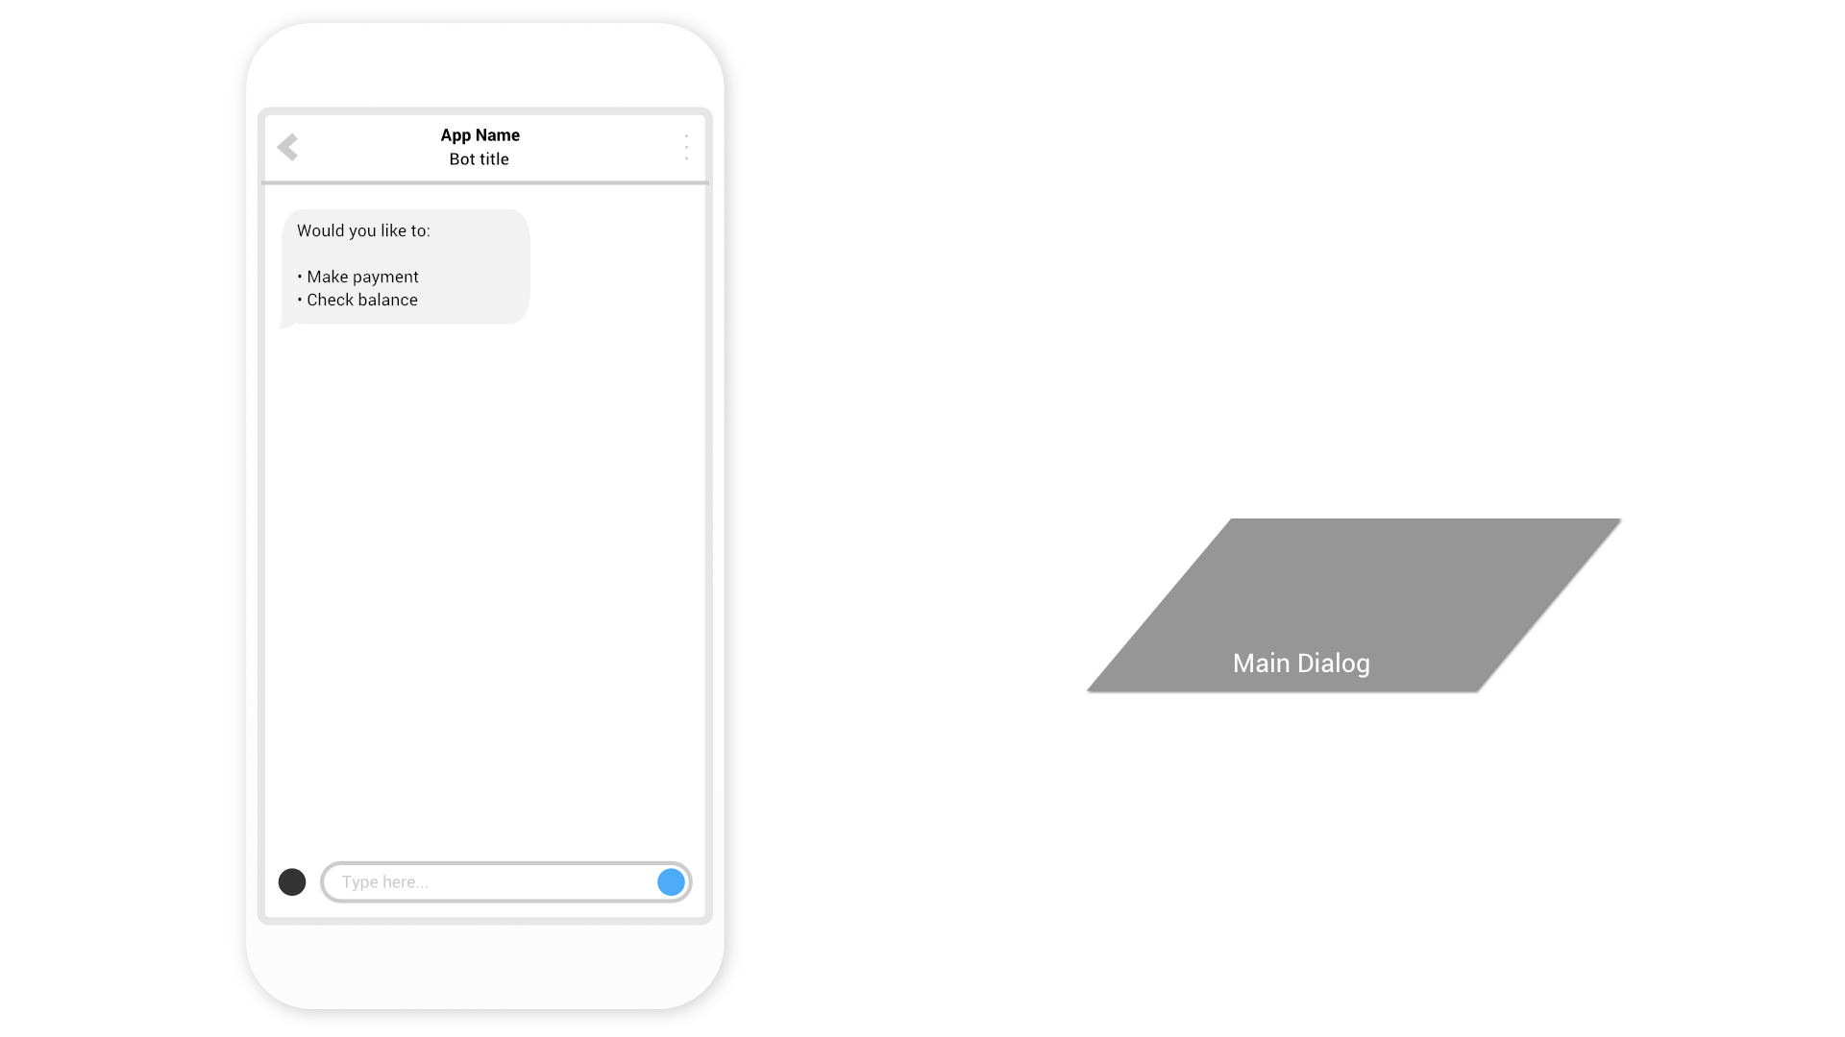

Slide 27
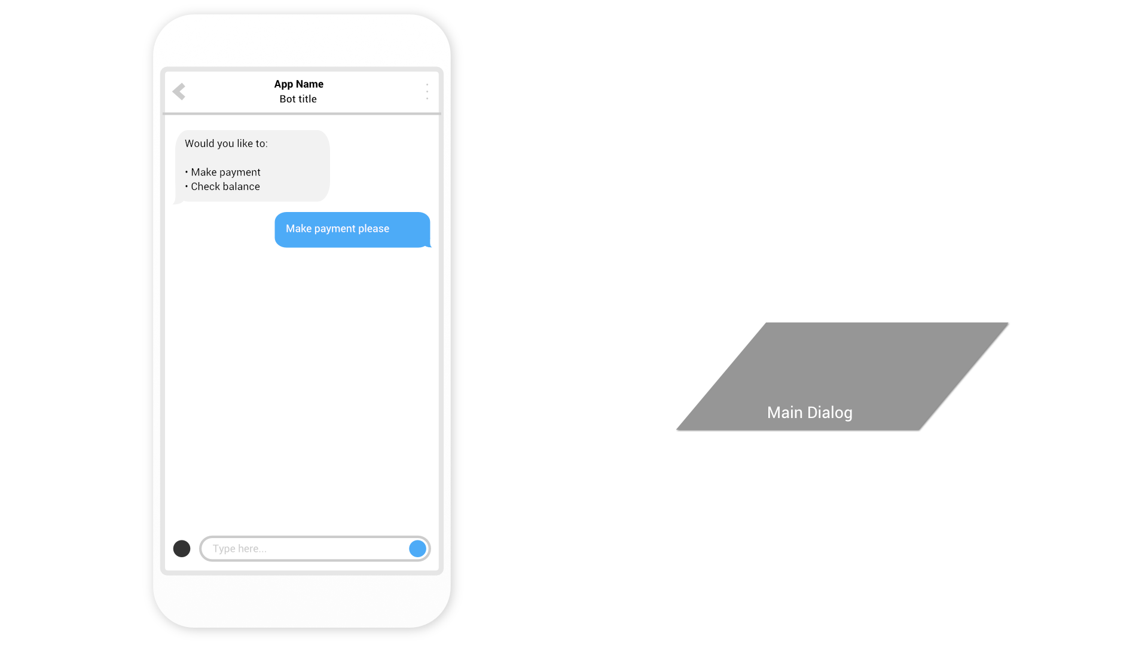

Slide 28
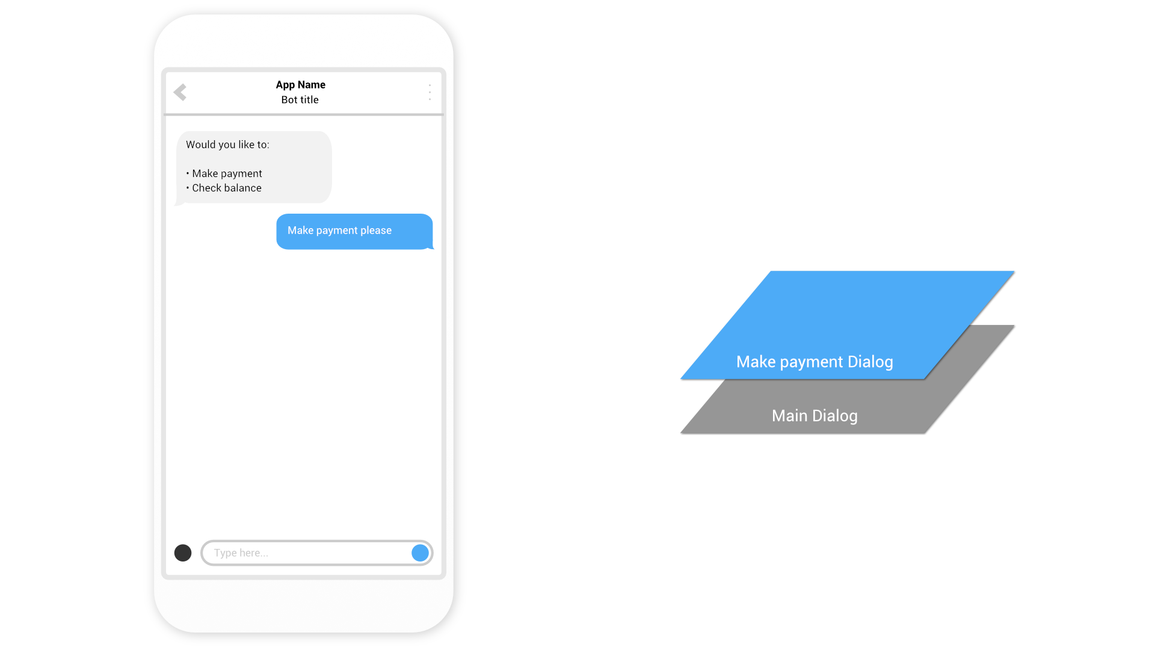

Slide 29


Slide 30
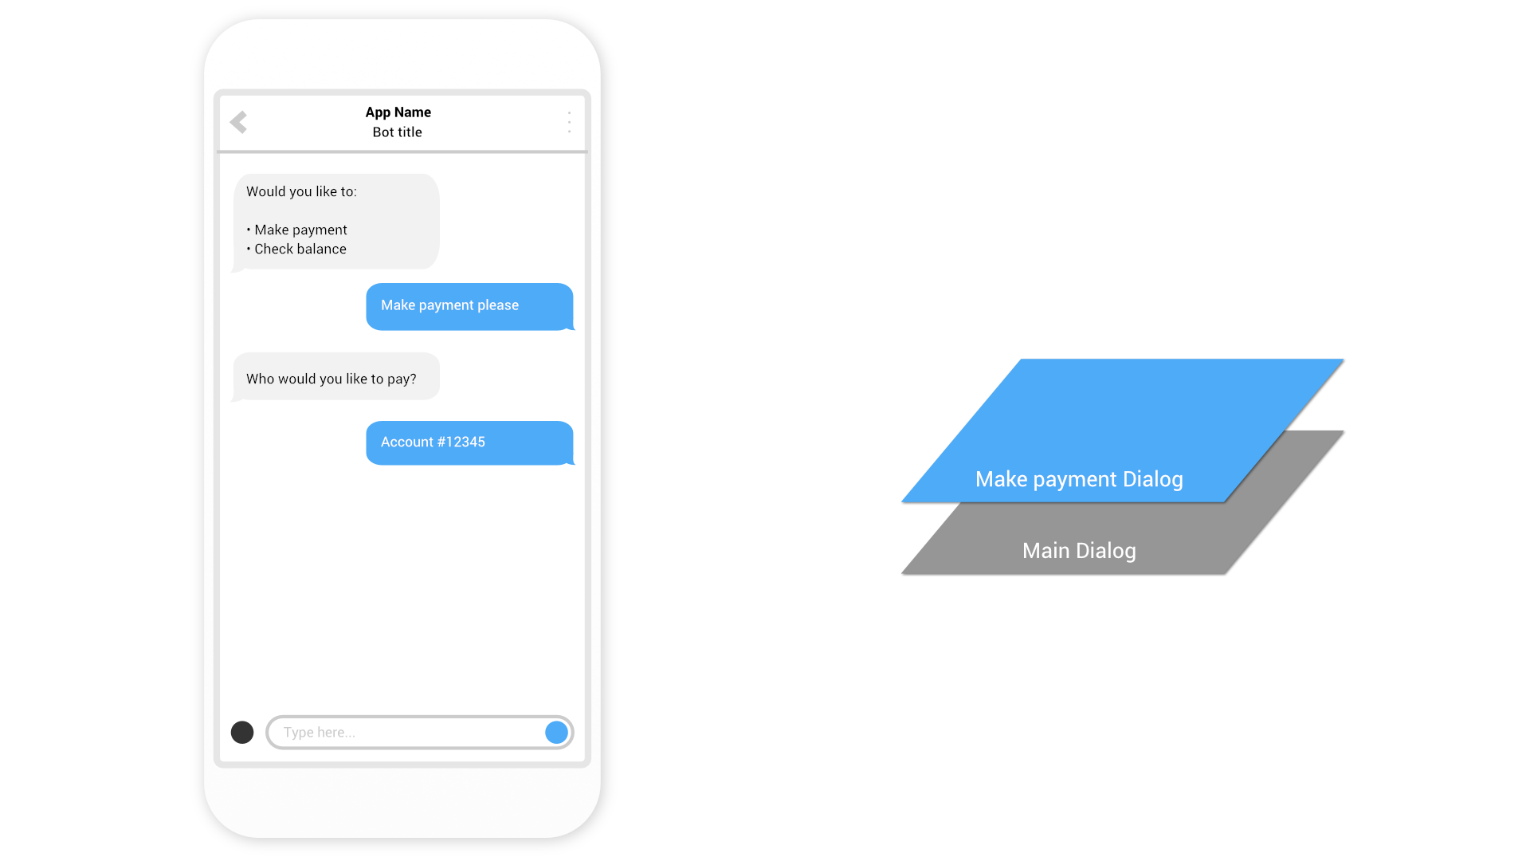

Slide 31


Slide 32
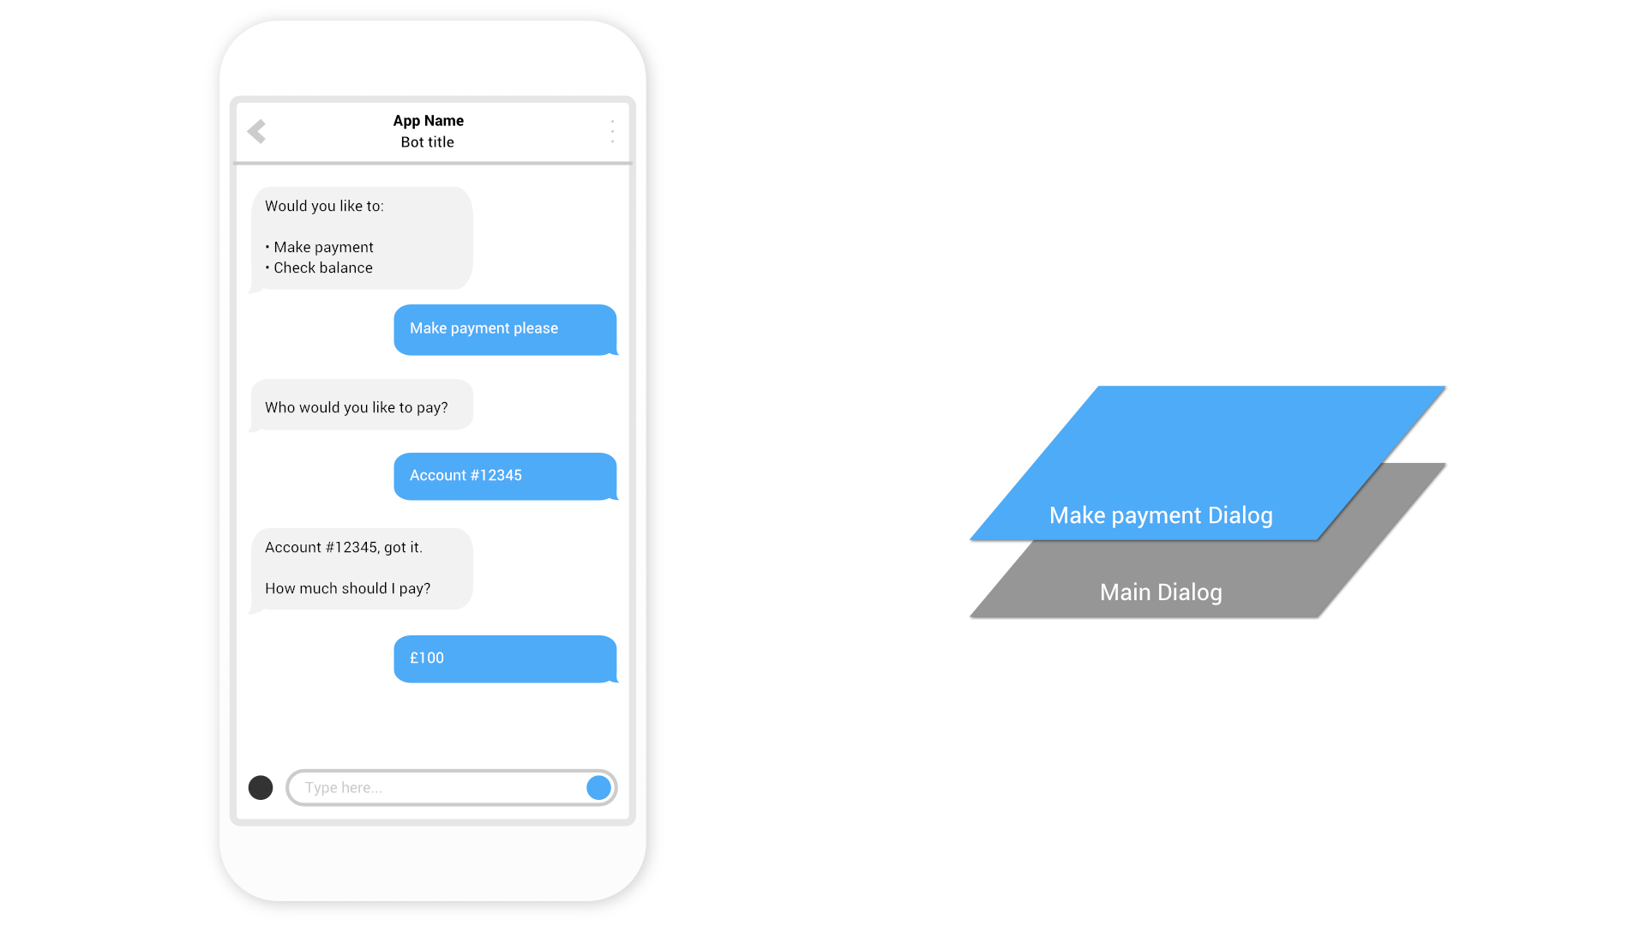

Slide 33
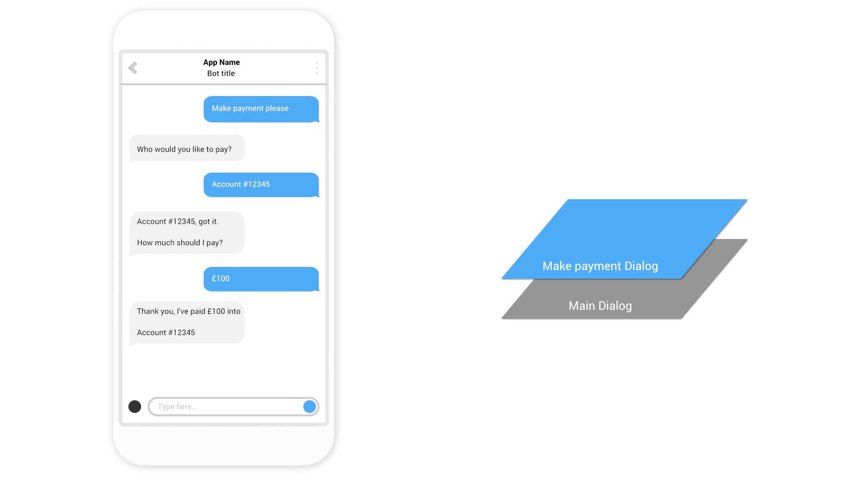

Slide 34
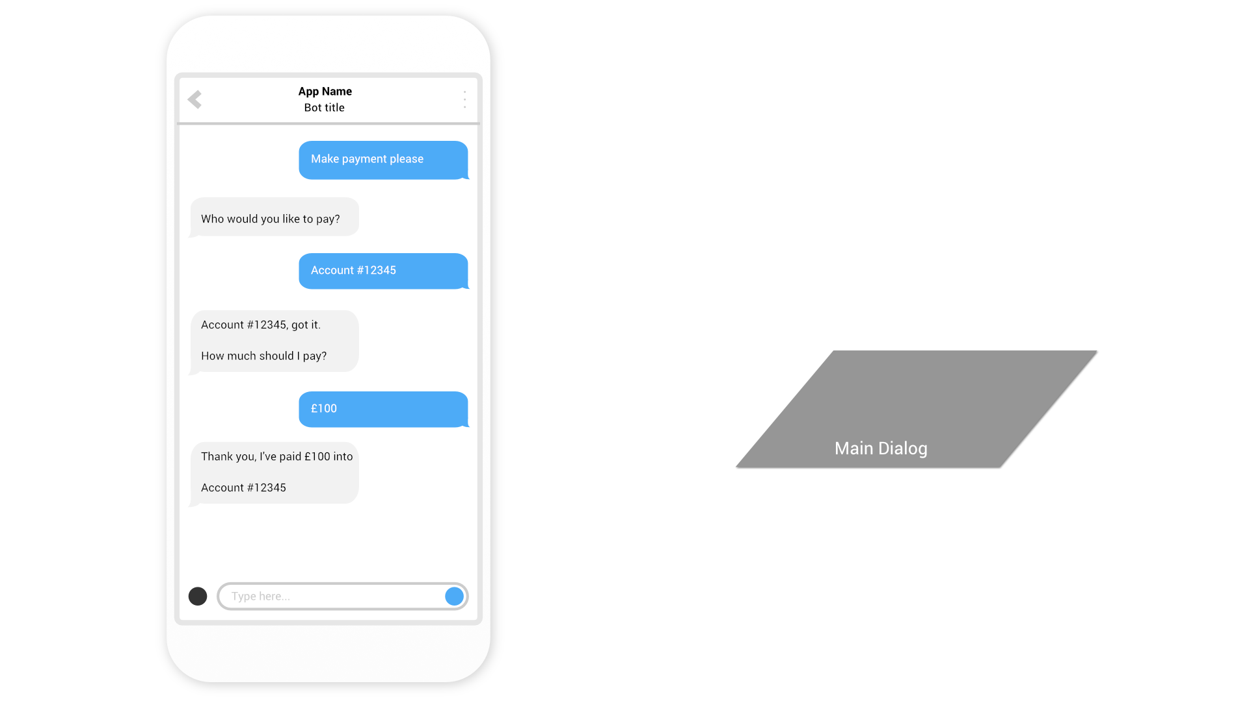

Slide 35
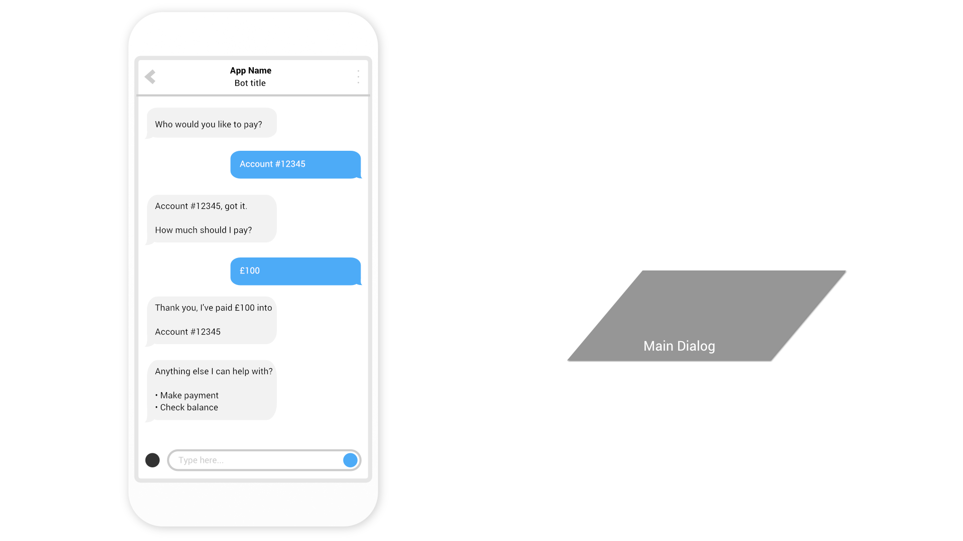

Slide 36
Dialog transitions
Context.Wait()
Wait for a user to send a message in the same Dialog
Context.Call() & Context.Forward()
Call another Dialog, adding it to the top of the stack, with or without passing a message to the child Dialog.
Context.Done()
Complete the current Dialog, removing it from the stack
Notes:
So how do we deliver this ‘layering’?
We use dialog transitions
There’s more , but these are the important ones

Slide 37
Demo
Banking Bot using Dialogs
@jamesemann
Notes:
Lets look at this in code

Slide 38
Form Flow
@jamesemann
Notes:
Next we can take a look at form flow.

Slide 39
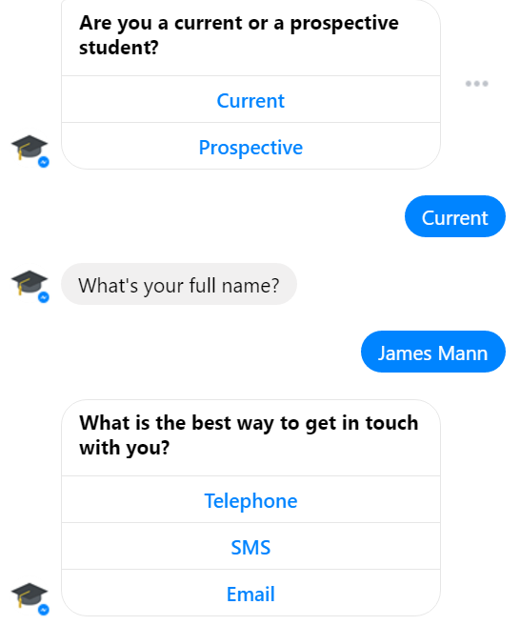
Form Flow
Form Flows are suited to data capture
Similar to a form in a traditional web page
Very simple to implement
Notes:
Think of form flow as a low resistance way to get simple “form based” applications running as a chat bot.
They provide several conveniences.
Are very simple to implement, but are limited. So it is very much a tradeoff.
You can combine formflow with dialogs, and other techniques, to get the best of both worlds.

Slide 40
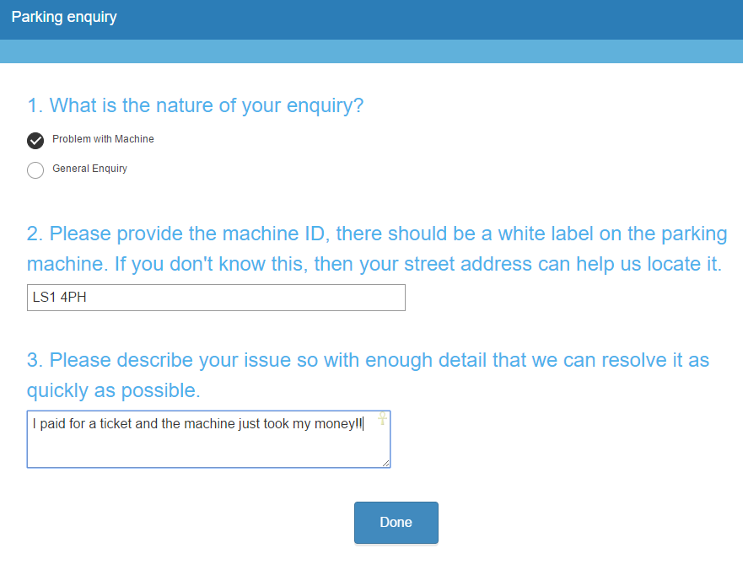
Parking enquiry chatbot
Notes:
So I wanted to put together an example here where users can log a parking enquiry – currently through a webform.
There are three simple fields, basically a checkbox saying what kind of enquiry the user as, then a field for the location, and another field detailing the product.
When the user fills it in they are shown the typical confirmation page. People are often felt like they are left hanging especially if they have a urgent enquiry

Slide 41
Demo
Form Flow chatbot
@jamesemann
Notes:
So lets take a look at how we can implement this using a bot.

Slide 42
QnA Maker
@jamesemann
Notes:
Now we will talk about the next technique we can use to build simple, FaQ, or command and control type bots

Slide 43
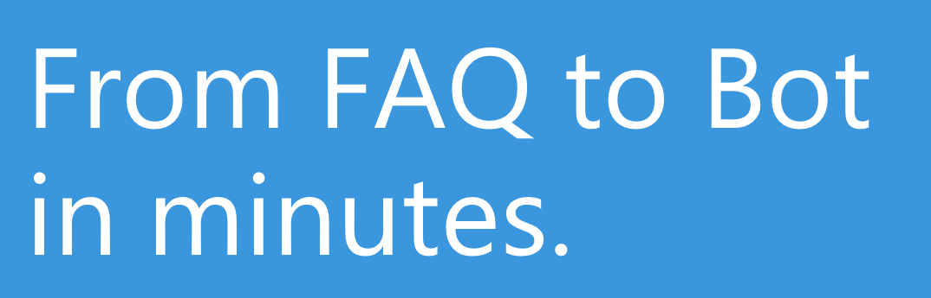

QnA Maker
Build, train and publish
Q&A bots based on existing FAQs
https://www.qnamaker.ai
Notes:
Common requirement for chat bots to surface answers to common questions
QnA Maker Service trains AI to respond to questions in a natural conversational way
Integrates easily with bots built using the Bot Framework – it is just a REST based API
Really easy way to get a bot up and running and start seeing the benefits!
http://qnamaker.ai
------------------------------------------------------
Brief overview of the QnA maker
Sign into qnamaker.ai
Create a new service using https://azure.microsoft.com/en-gb/support/faq/
Try "What does it mean if a service is in preview" -> show that we receive the right answer
Talk about training
Try "How do I raise a support request?" -> We get an answer but not the right one. Let's type "How do I submit a support request?" -> Get the right answer and add "How do I raise a support ticket?" as alternative phrase and re-train
Now try "How do I create a ticket with support?" -> get the right answer
Publish the service
Switch to bot demo in VS and show how we are calling our QnA Maker service and demo the bot
Maybe show my QnAMakerDialog available on NuGet??? YES

Slide 44
Demo
qnamaker.ai
@jamesemann
Notes:
Lets take a look at the UI

Slide 45
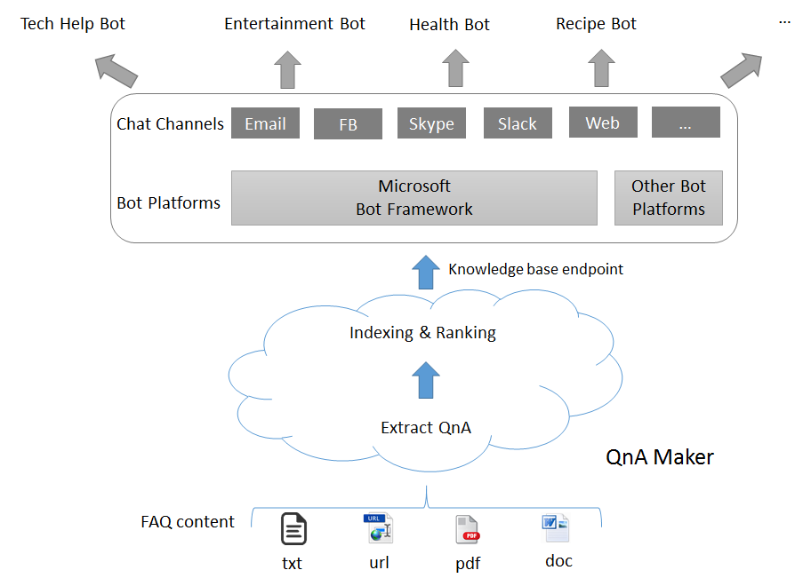
Demo
Banking bot using Dialogs
@jamesemann

Slide 46
Demo
QnA Maker chatbot
@jamesemann
Notes:
So we have an api that we can consume with any app, but it makes sense to hook it up to a bot so lets see how easy it is to do that

Slide 47
luis.ai
@jamesemann
Notes:
The final topic we will cover briefly deals with layering in natural language processing using luis.ai to recognise users intent.

Slide 48
luis.ai terminology
Utterance (input)
A spoken or written message
Intent (output)
What is the user intending to do?
Entity (output)
What objects are being referred to?
“Set the temperature in the kitchen to 21 degrees”
“Set the temperature in the kitchen to 21 degrees”
“Set the temperature in the kitchen to 21 degrees”
Notes:
There’s more , but these are the important ones

Slide 49
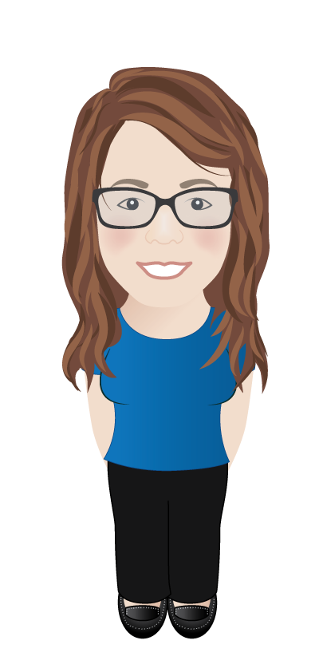
luis.ai intent recognition & entity extraction
“Set the temperature in the kitchen to 21 degrees”
“Set the temperature in the kitchen to 21 degrees”
“Set the temperature in the kitchen to 21 degrees”
Intent
Set temperature
Model
(luis.ai API)
Entities
Room = Kitchen
Value = 21 degrees
Notes:
So taking those concepts through a home automation example

Slide 50
luis.ai components
Portal
Api
Define
Train
Publish
Consume
Notes:
Portal
Used to define intents and entities, and to train the model
Api
Used to consume the model, i.e. understand the intent of sentences

Slide 51
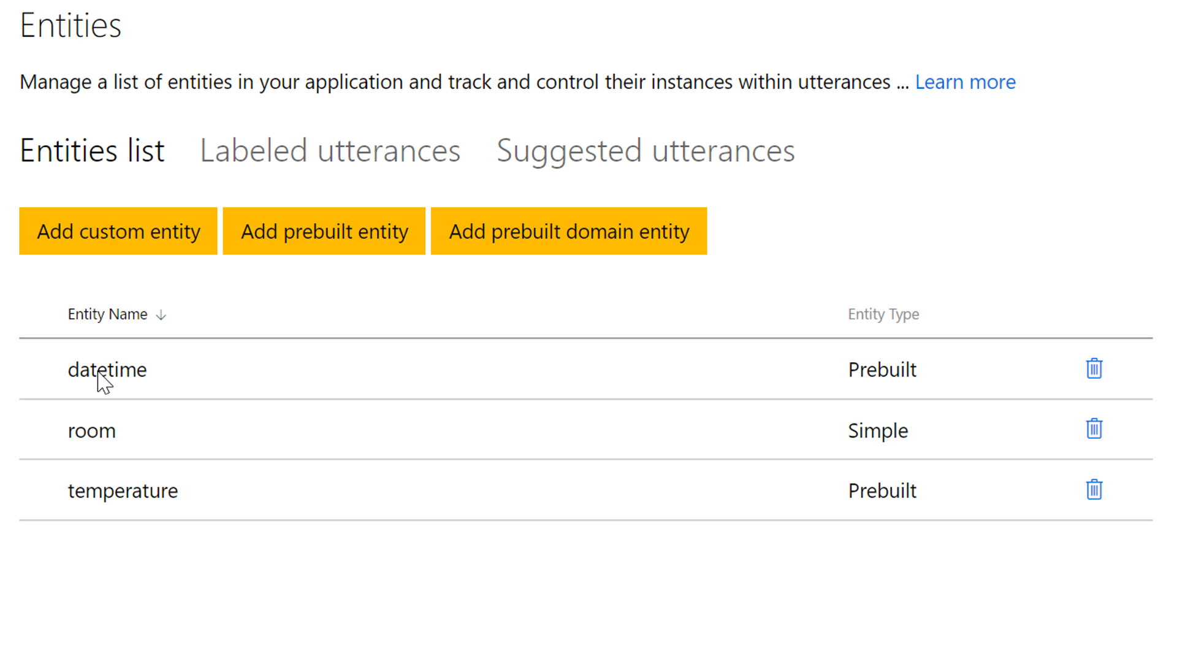
Home automation chatbot
Notes:
I want to create a chatbot to set the temperature turn on lights etc, but I want it to be natural and work with plain English
So I’ve created a model in luis.ai which I am showing you as screenshots for expediency.
This is deployed out and available as an API endpoint.

Slide 52
Notes:
So I have a list of ENTITIES as discussed

Slide 53
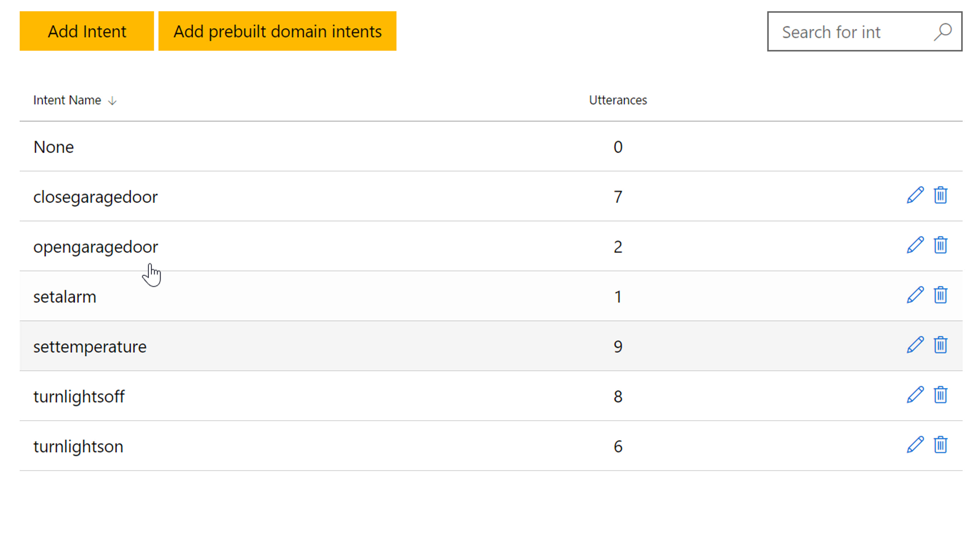
Notes:
And 6 intents for different commands

Slide 54
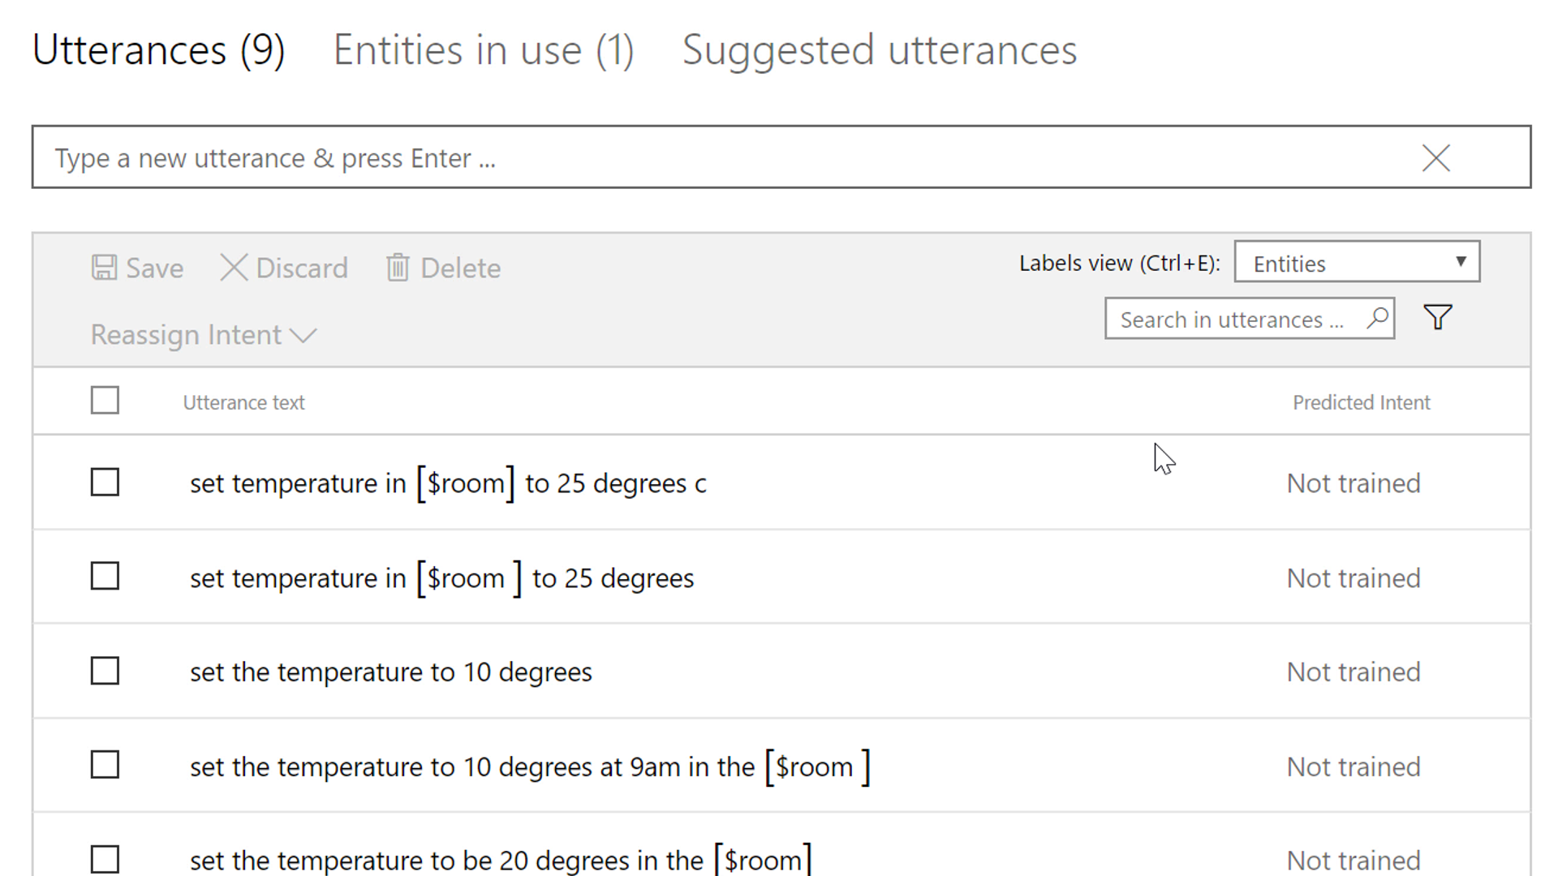
Notes:
If I click into the intents I can see example utterances

Slide 55
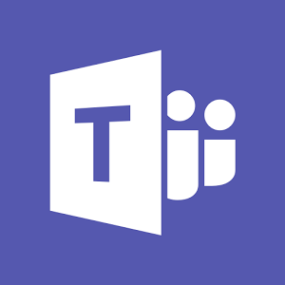
A more intelligent chatbot
Channels
Bot Application
luis.ai
Other Business Logic / Dialogs etc.
Luis Dialog
Model
API Controller
Notes:
So with that in mind, this is what we want to achieve.

Slide 56
Demo
Home automation chatbot
@jamesemann
Notes:
Lets take a look at how we can do it
Facebook messenger bot

Slide 57
Thank you!
Create an account @ dev.botframework.com
Download the emulator + Node/C# SDK
Start providing a conversational interface to your existing apps!
Notes:
There’s more , but these are the important ones

Slide 58


Slide 59
Resources
Blogs:
James Mann:
blogs.blackmarble.co.uk/blogs/jmann/
Twitter:
@jamesemann
https://github.com/jamesemann/ddd2017
Useful links:
Bot samples, tutorials, case studies:
aka.ms/botresources
Bot framework:
dev.botframework.com
github.com/microsoft/BotBuilder
github.com/microsoft/BotBuilder-samples
Cognitive Services:
aka.ms/cognitive
MICROSOFT
Notes:
Introductions and Agenda (2 Mins)
Introduce Simon, Gary, James
Set expectations: intro to bot framework.
Very quick demo of JUST EAT to show what a bot is
What we are going to cover

